Slide 1
Document management
Aleksandra Maksimowska (11031917)
Michał Jagoda (11031910)
Group 156

Slide 2
Pure HTML version

Slide 3
Document management (Pure HTML version) 1/2
The application supports user registration and login via a public page with appropriate forms. Registration requires entering a username, email address, and password, and checks the syntactic validity of the email address and the equality between the "password" and "repeat password" fields, also on the client side. The registration ensures the uniqueness of the username.
A folder has an owner, a name, and a creation date, and can contain other folders and/or documents. A document has an owner, a name, a creation date, a summary, and a type. When the user logs into the application, a HOME PAGE appears containing a tree of their folders and subfolders.
Example of a folder tree on the HOME PAGE
Folder 1
Folder 11
Folder 111
Folder 12
Folder 13
Folder 2
Folder 21
Folder 3
Folder 31
Folder 111
Contents of the CONTENT PAGE of a folder
Document 1 > access > move
Document 2 > access > move
Document 3 > access > move

Slide 4
Document management (Pure HTML version) 2/2
On the HOME PAGE, the user can select a folder and access a CONTENT PAGE which shows a list of folders and documents in a folder. Each document in the list has two links: access and move. When the user selects the access link, a DOCUMENT PAGE (in the same window and browser tab) appears, showing all the data of the selected document. When the user selects the move link, the HOME PAGE with the folder tree appears; in this case, the page shows the message "You are moving document X from folder Y. Choose the destination folder", the folder to which the document to be moved belongs is NOT selectable and its name is highlighted (for example, with a different color). When the user selects the destination folder, the document is moved from the source folder to the destination folder, and the CONTENT PAGE appears, showing the updated content of the destination folder. Every page, except the HOME PAGE, contains a link to return to the previous page. The application allows the user to log out from any page. A CONTENT MANAGEMENT PAGE accessible from the HOME PAGE allows the user to create a top-level folder, a folder within an existing folder, and a document within a folder. The application does not require the management of document uploads.

Slide 5
Data Analysis (Pure HTML version) 1/2
The application supports user registration and login via a public page with appropriate forms. Registration requires entering a username, email address, and password, and checks the syntactic validity of the email address and the equality between the "password" and "repeat password" fields, also on the client side. The registration ensures the uniqueness of the username.
A folder has an owner, a name, and a creation date, and can contain other folders and/or documents. A document has an owner, a name, a creation date, a summary, and a type. When the user logs into the application, a HOME PAGE appears containing a tree of their folders and subfolders.
Example of a folder tree on the HOME PAGE
Folder 1
Folder 11
Folder 111
Folder 12
Folder 13
Folder 2
Folder 21
Folder 3
Folder 31
Folder 111
Contents of the CONTENT PAGE of a folder
Document 1 > access > move
Document 2 > access > move
Document 3 > access > move
Entity Relation Attribute

Slide 6
Data Analysis (Pure HTML version) 2/2
On the HOME PAGE, the user can select a folder and access a CONTENT PAGE which shows a list of folders and documents in a folder. Each document in the list has two links: access and move. When the user selects the access link, a DOCUMENT PAGE (in the same window and browser tab) appears, showing all the data of the selected document. When the user selects the move link, the HOME PAGE with the folder tree appears; in this case, the page shows the message "You are moving document X from folder Y. Choose the destination folder", the folder to which the document to be moved belongs is NOT selectable and its name is highlighted (for example, with a different color). When the user selects the destination folder, the document is moved from the source folder to the destination folder, and the CONTENT PAGE appears, showing the updated content of the destination folder. Every page, except the HOME PAGE, contains a link to return to the previous page. The application allows the user to log out from any page. A CONTENT MANAGEMENT PAGE accessible from the HOME PAGE allows the user to create a top-level folder, a folder within an existing folder, and a document within a folder. The application does not require the management of document uploads.
Entity Relation Attribute

Slide 7
Requirements analysis (Pure HTML version) 1/2
The application supports user registration and login via a public page with appropriate forms. Registration requires entering a username, email address, and password, and checks the syntactic validity of the email address and the equality between the "password" and "repeat password" fields, also on the client side. The registration ensures the uniqueness of the username.
A folder has an owner, a name, and a creation date, and can contain other folders and/or documents. A document has an owner, a name, a creation date, a summary, and a type. When the user logs into the application, a HOME PAGE appears containing a tree of their folders and subfolders.
Example of a folder tree on the HOME PAGE
Folder 1
Folder 11
Folder 111
Folder 12
Folder 13
Folder 2
Folder 21
Folder 3
Folder 31
Folder 111
Contents of the CONTENT PAGE of a folder
Document 1 > access > move
Document 2 > access > move
Document 3 > access > move
Pages View components Events Actions

Slide 8
Requirements analysis (Pure HTML version) 2/2
On the HOME PAGE, the user can select a folder and access a CONTENT PAGE which shows a list of folders and documents in a folder. Each document in the list has two links: access and move. When the user selects the access link, a DOCUMENT PAGE (in the same window and browser tab) appears, showing all the data of the selected document. When the user selects the move link, the HOME PAGE with the folder tree appears; in this case, the page shows the message "You are moving document X from folder Y. Choose the destination folder", the folder to which the document to be moved belongs is NOT selectable and its name is highlighted (for example, with a different color). When the user selects the destination folder, the document is moved from the source folder to the destination folder, and the CONTENT PAGE appears, showing the updated content of the destination folder. Every page, except the HOME PAGE, contains a link to return to the previous page. The application allows the user to log out from any page. A CONTENT MANAGEMENT PAGE accessible from the HOME PAGE allows the user to create a top-level folder, a folder within an existing folder, and a document within a folder. The application does not require the management of document uploads.
Pages View components Events Actions

Slide 9
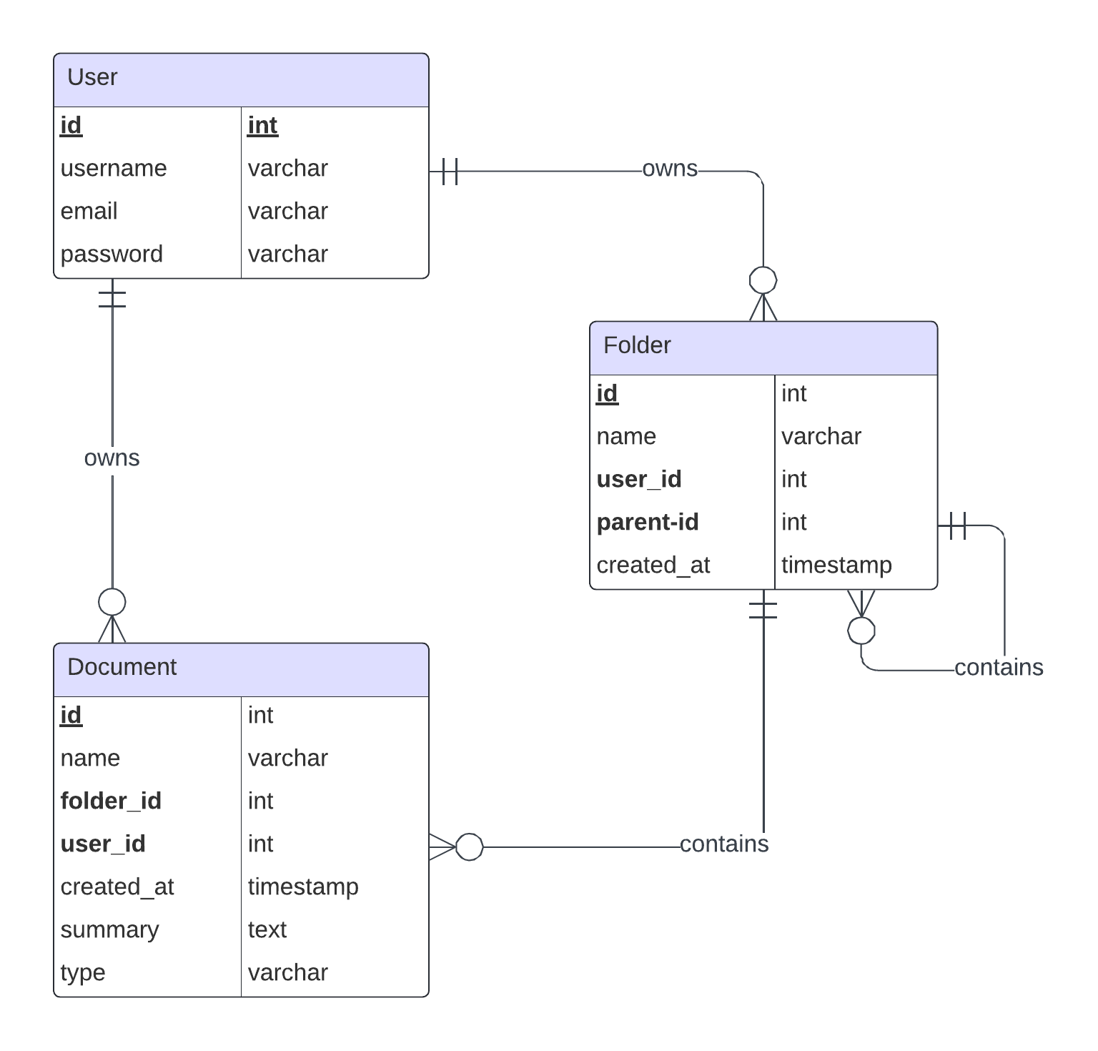
Database ERD

Slide 10
Database schema (users)
CREATE TABLE `users` (
`id` int NOT NULL AUTO_INCREMENT,
`username` varchar(45) NOT NULL,
`email` varchar(45) NOT NULL,
`password` varchar(45) NOT NULL,
PRIMARY KEY (`id`),
UNIQUE KEY `email_UNIQUE` (`email`),
UNIQUE KEY `username_UNIQUE` (`username`),
UNIQUE KEY `id_UNIQUE` (`id`)
) ENGINE=InnoDB AUTO_INCREMENT=3 DEFAULT CHARSET=utf8mb4 COLLATE=utf8mb4_0900_ai_ci

Slide 11
Database schema (folders)
CREATE TABLE `folders` (
`id` int NOT NULL AUTO_INCREMENT,
`name` varchar(255) NOT NULL,
`user_id` int NOT NULL,
`parent_id` int DEFAULT NULL,
`created_at` timestamp NULL DEFAULT CURRENT_TIMESTAMP,
PRIMARY KEY (`id`),
KEY `fk_folders_users` (`user_id`),
KEY `fk_folders_parent` (`parent_id`),
CONSTRAINT `fk_folders_parent` FOREIGN KEY (`parent_id`) REFERENCES `folders` (`id`),
CONSTRAINT `fk_folders_users` FOREIGN KEY (`user_id`) REFERENCES `users` (`id`)
) ENGINE=InnoDB AUTO_INCREMENT=52 DEFAULT CHARSET=utf8mb4 COLLATE=utf8mb4_0900_ai_ci

Slide 12
Database schema (documents)
CREATE TABLE `documents` (
`id` int NOT NULL AUTO_INCREMENT,
`name` varchar(255) NOT NULL,
`folder_id` int DEFAULT NULL,
`user_id` int NOT NULL,
`created_at` timestamp NULL DEFAULT CURRENT_TIMESTAMP,
`summary` text, `type` varchar(255) DEFAULT NULL,
PRIMARY KEY (`id`), KEY `folder_id` (`folder_id`),
KEY `fk_documents_users` (`user_id`),
CONSTRAINT `documents_ibfk_1` FOREIGN KEY (`folder_id`) REFERENCES `folders` (`id`) ON DELETE CASCADE,
CONSTRAINT `fk_documents_users` FOREIGN KEY (`user_id`) REFERENCES `users` (`id`)
) ENGINE=InnoDB AUTO_INCREMENT=29 DEFAULT CHARSET=utf8mb4 COLLATE=utf8mb4_0900_ai_ci

Slide 13
Components
Model objects (Beans)
User
Document
Folder
Views
login.html
register.html
home.html
Filters
AuthenticationFilter
CsrfFilter
LoggingFilter
Controllers (Servlets)
ContentManagementServlet
ContentServlet
DocumetnServlet
FolderServlet
HomeServlet
LoginServlet
LogoutServlet
MoveDocumentServlet
RegisterServlet
ViewDocumentServlet
Utils
DatabaseUtils
SecurityUtils
ThymeleafConfig

Slide 14
Components
Views (templates):
contentManagement.html
content.html
document.html
fragments.html
home.html
login.html
moveDocument.html
register.html
viewDocument.html

Slide 15
IFML diagram (pure HTML version)

Slide 16
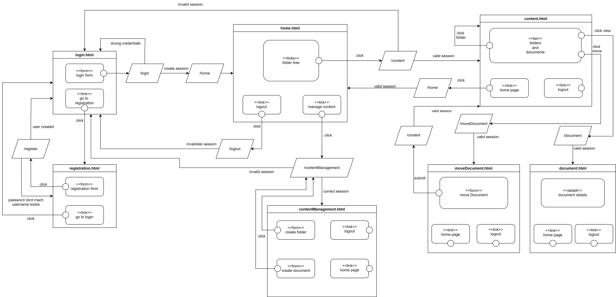

Slide 17
Sequence diagrams (pure HTML version)

Slide 18
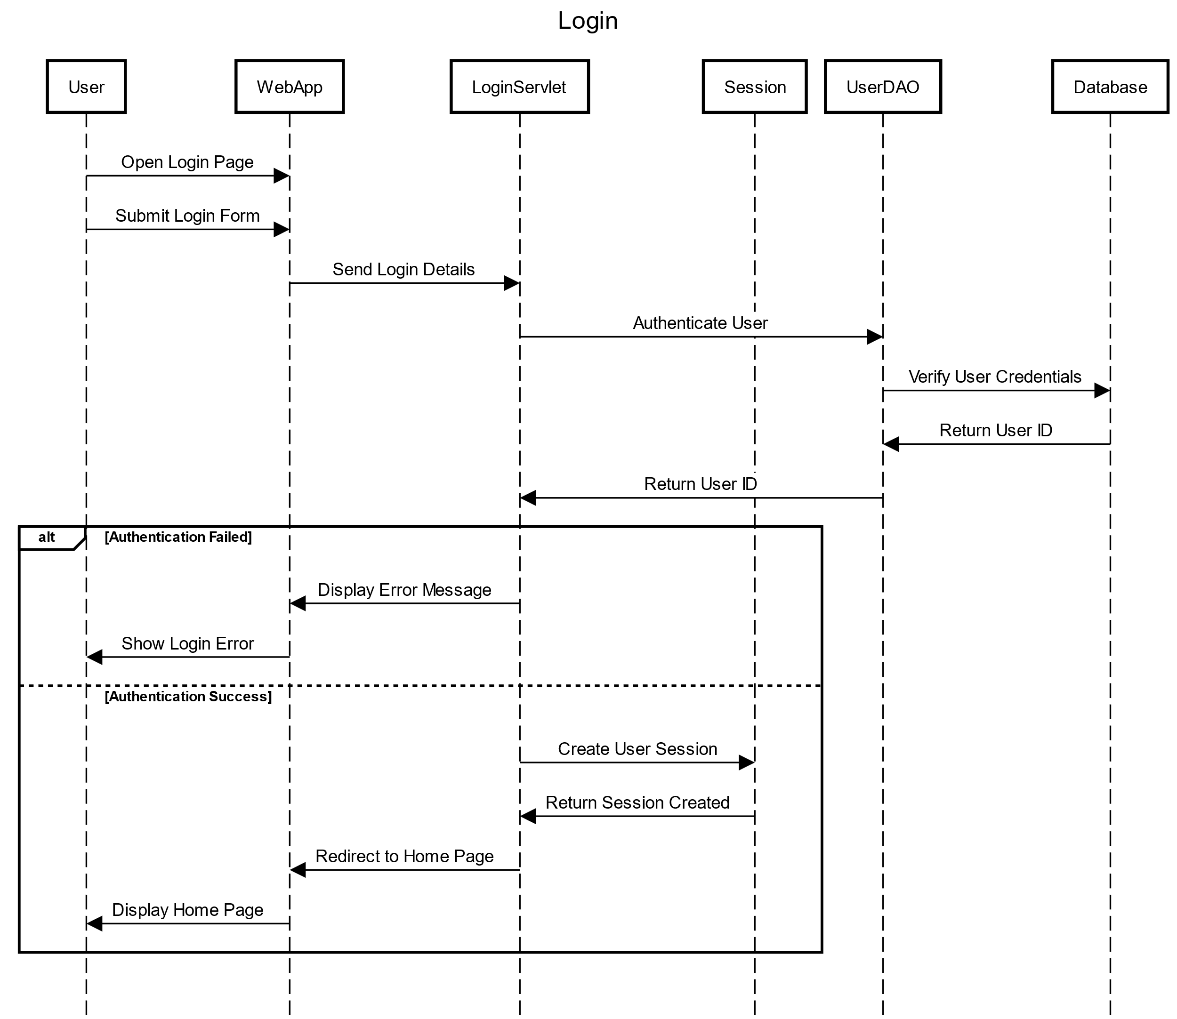

Slide 19
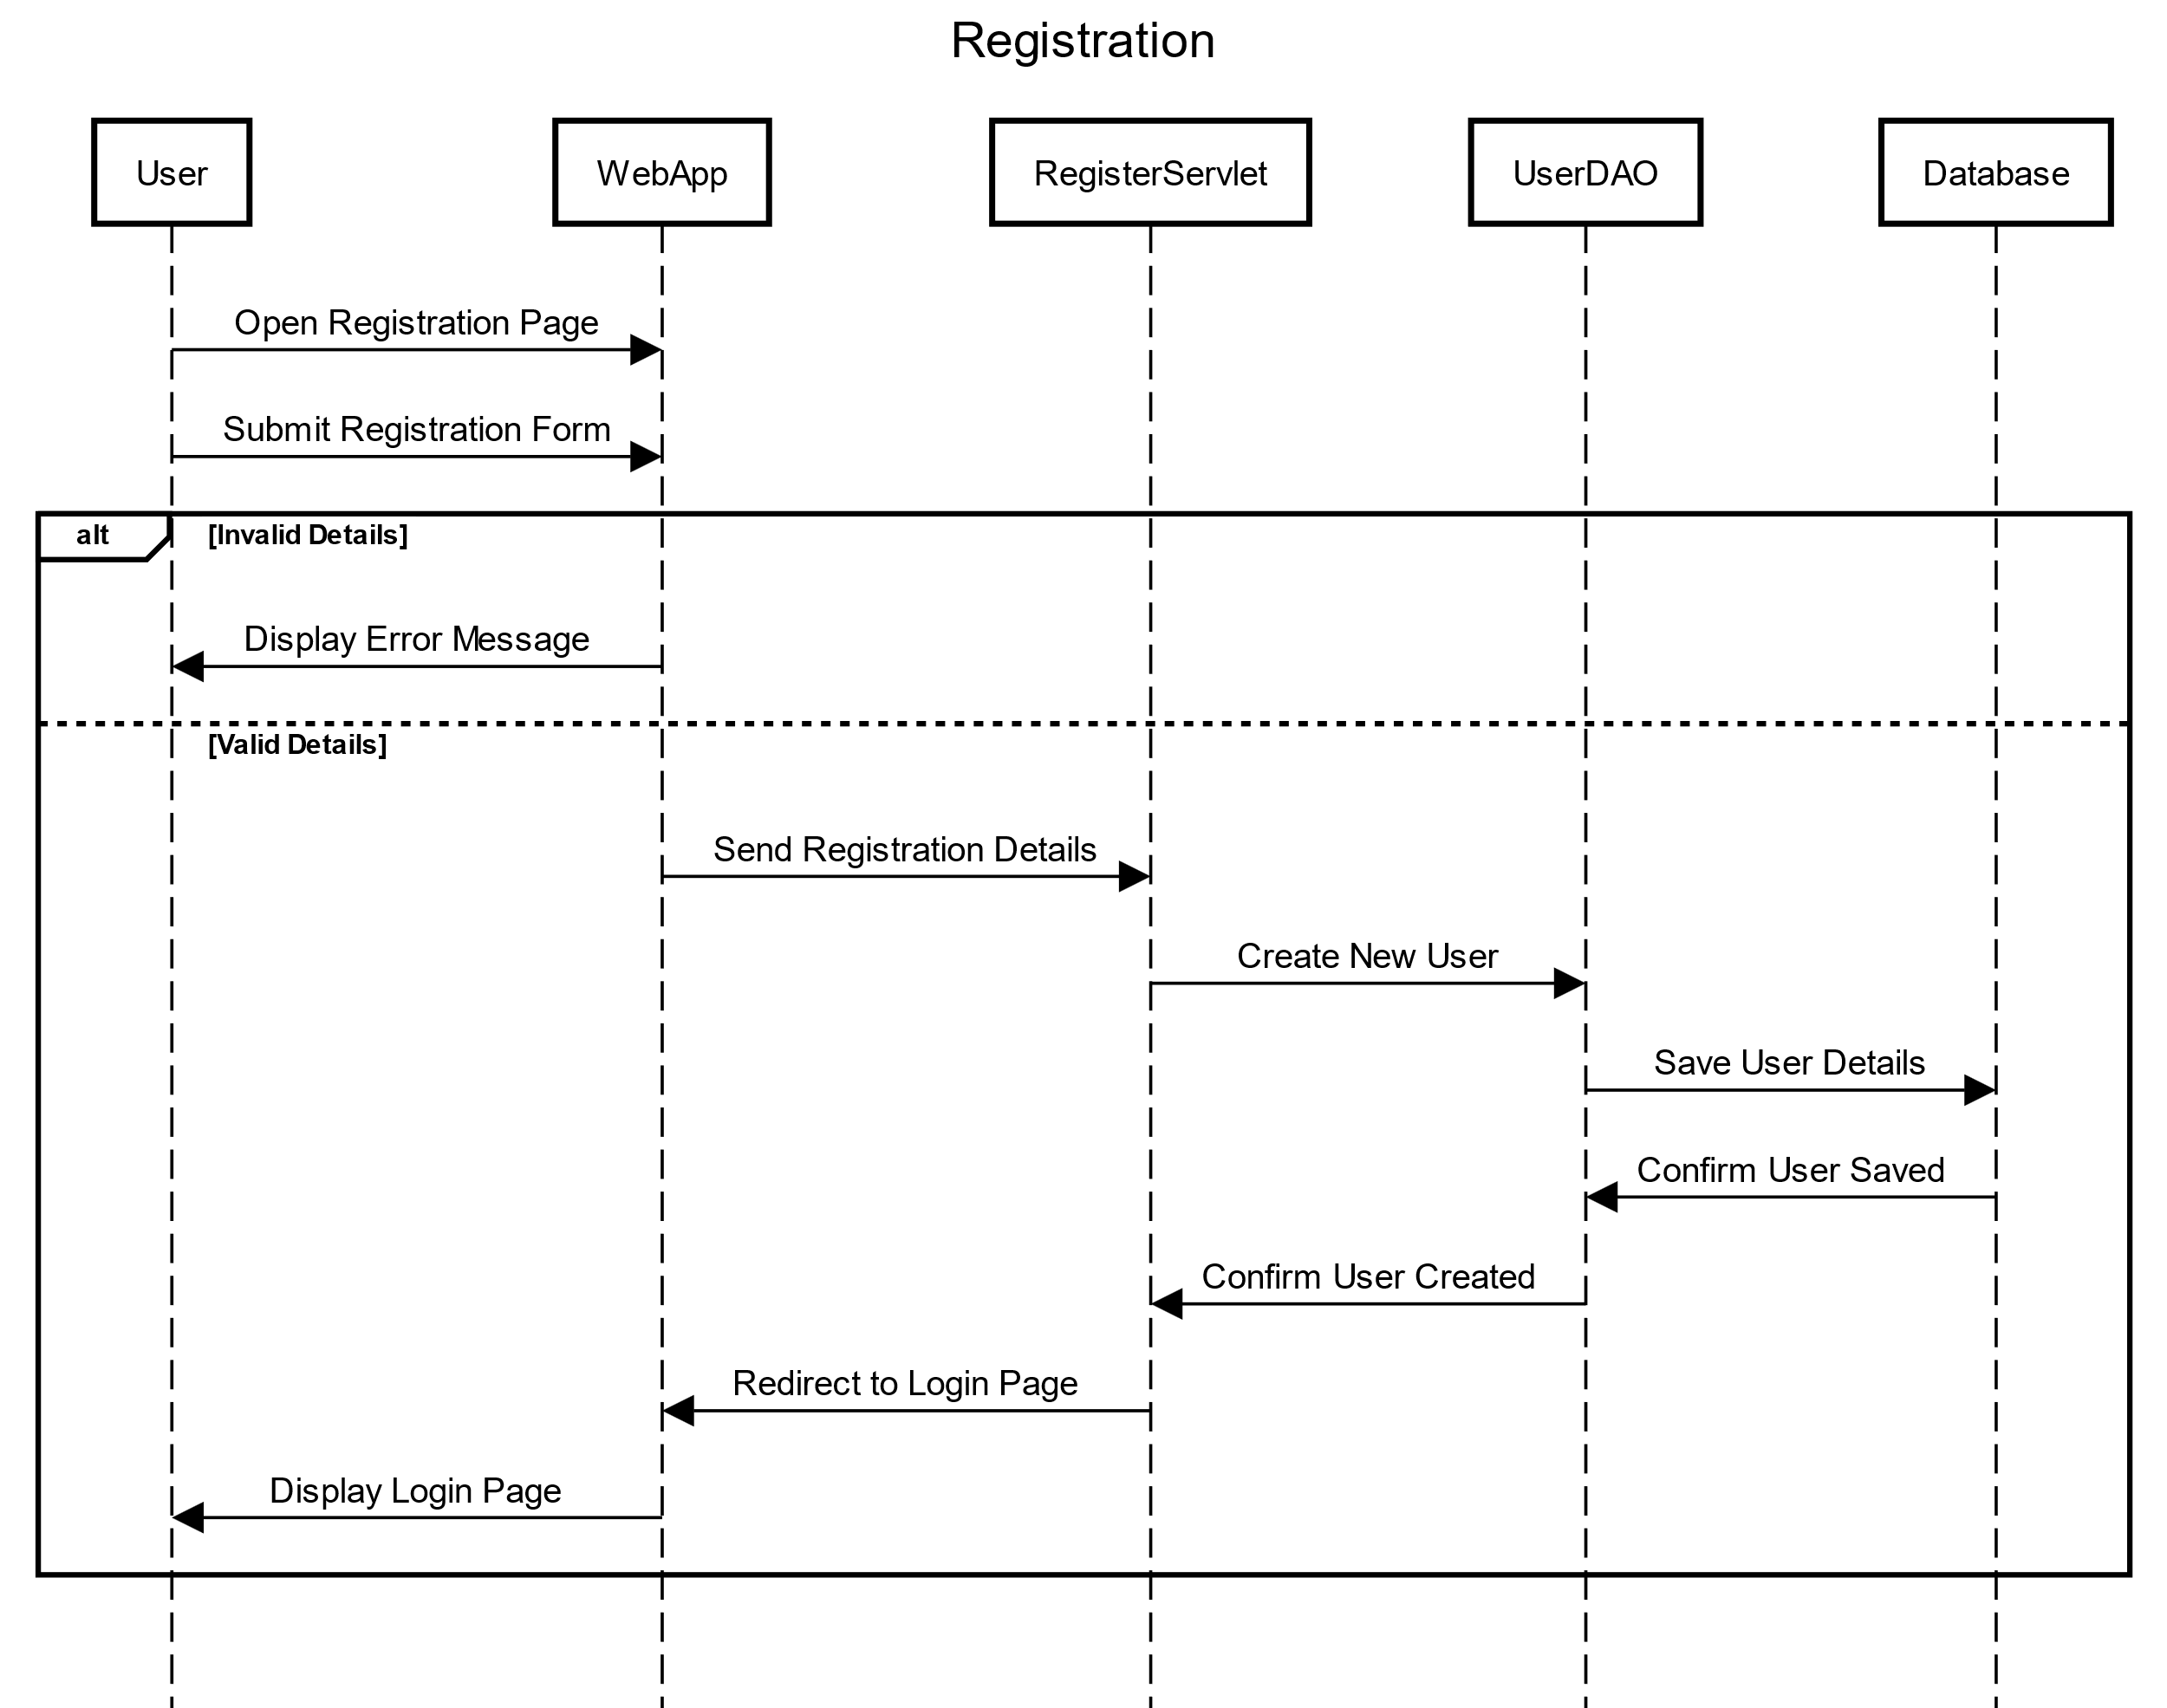

Slide 20
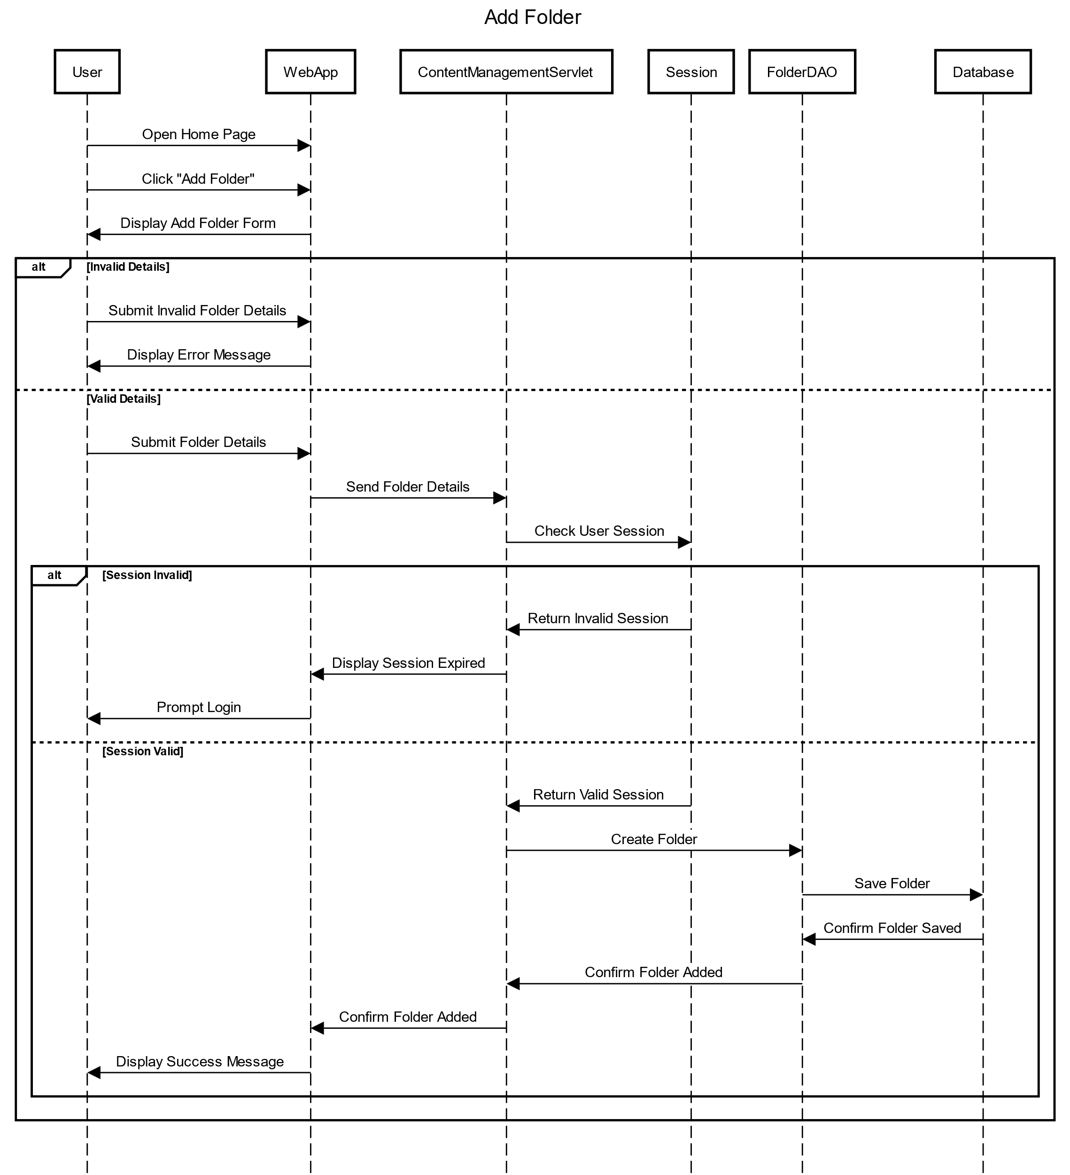

Slide 21
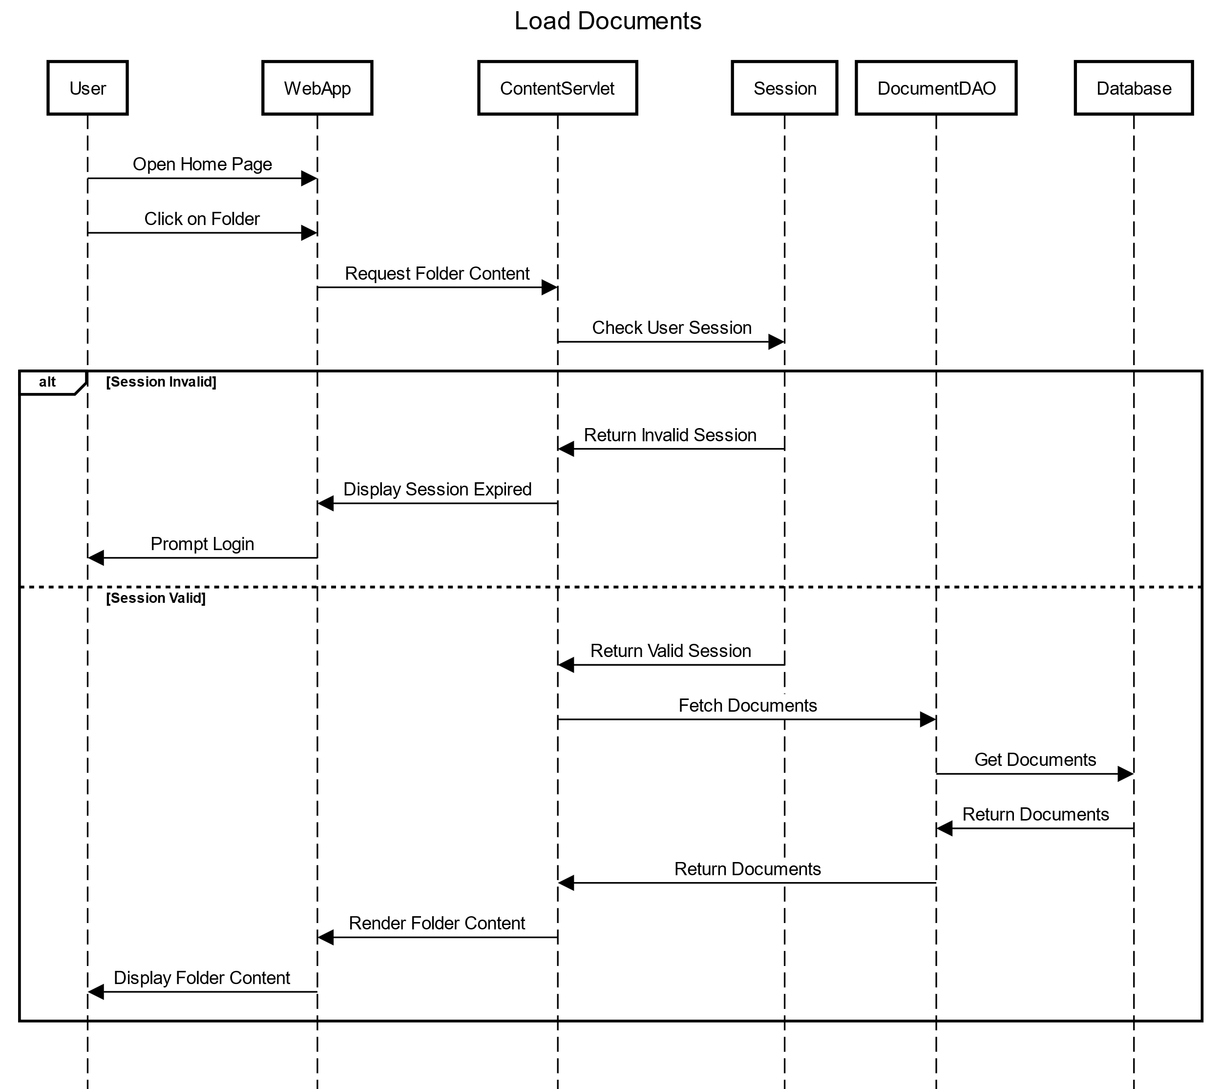

Slide 22
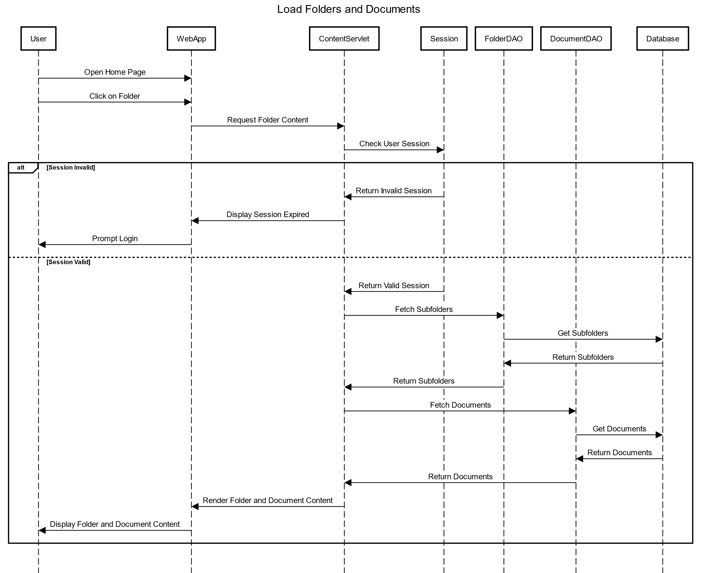

Slide 23
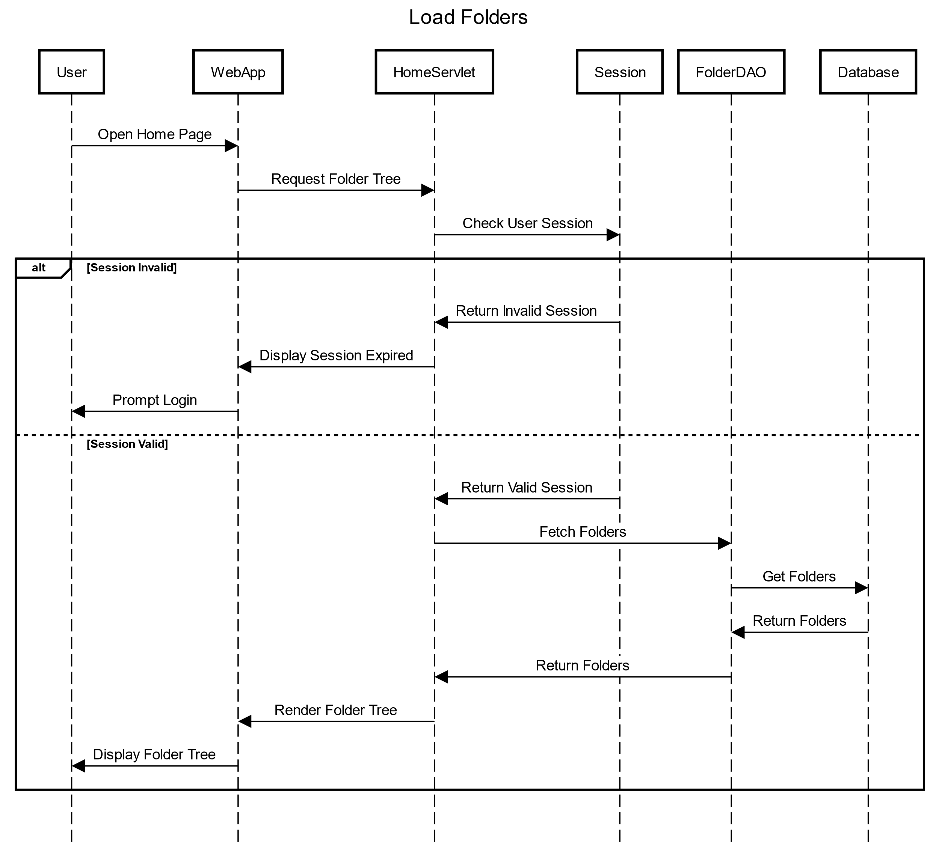

Slide 24
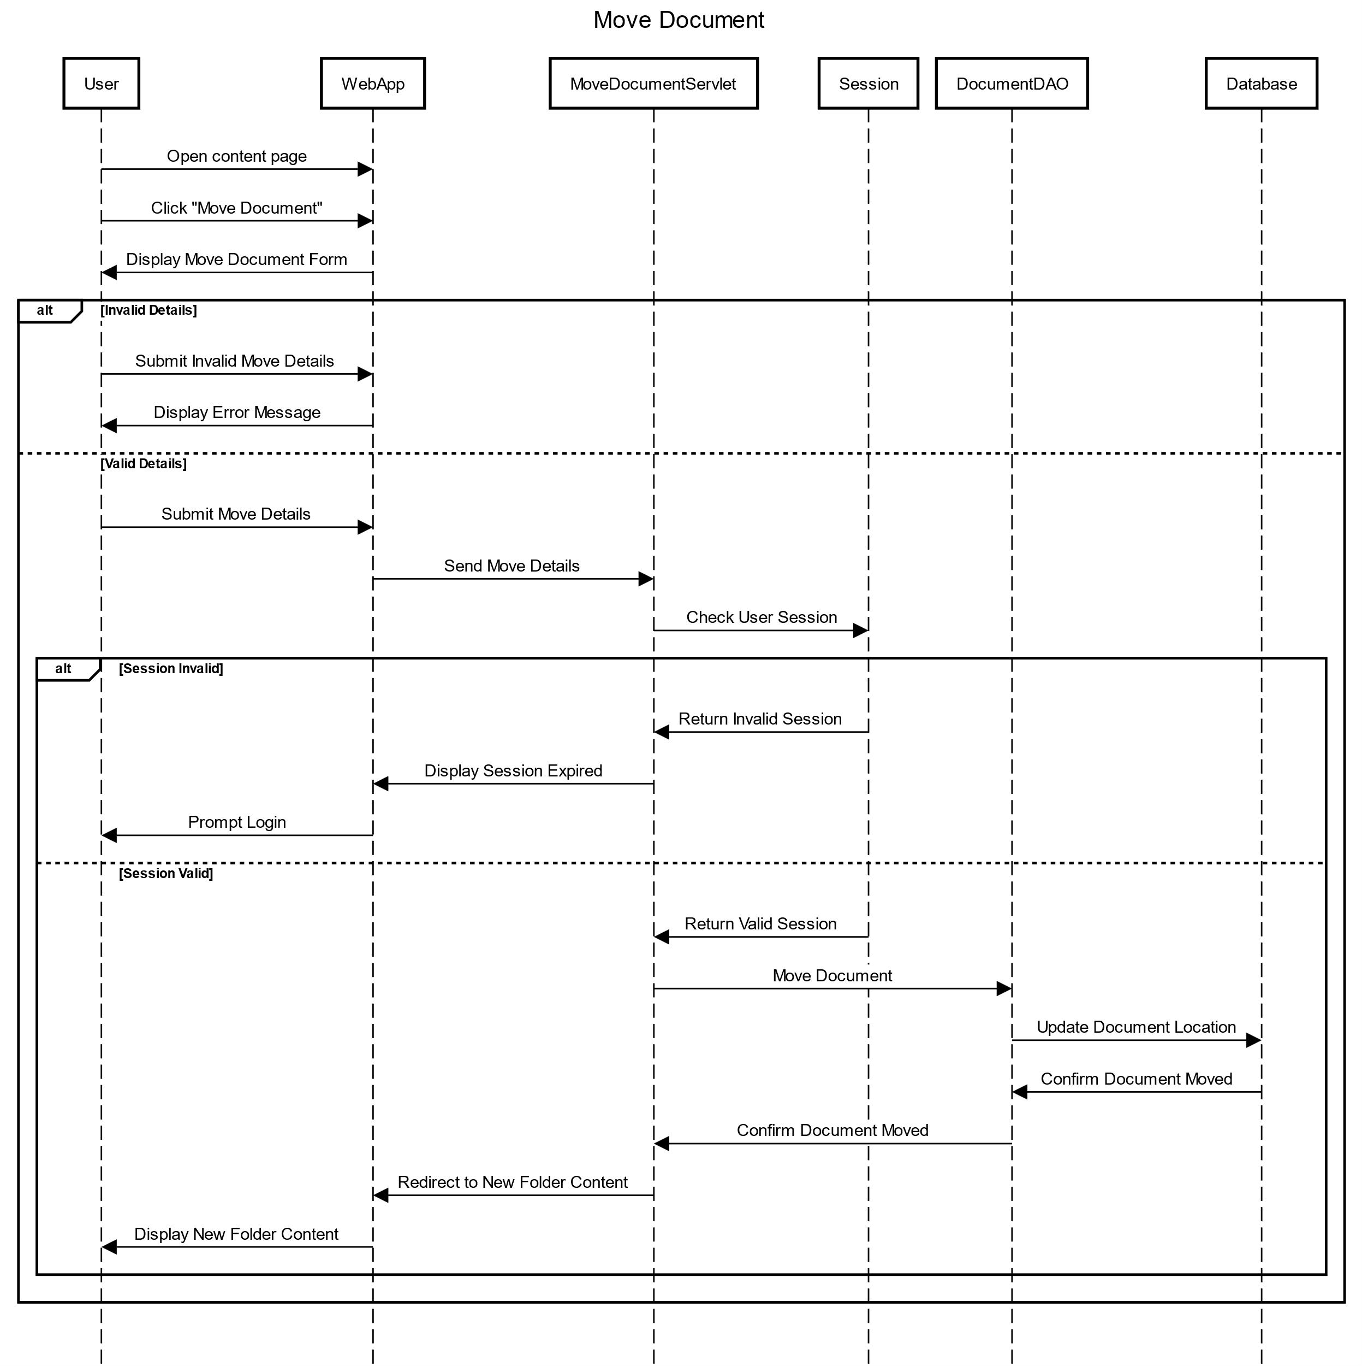

Slide 25
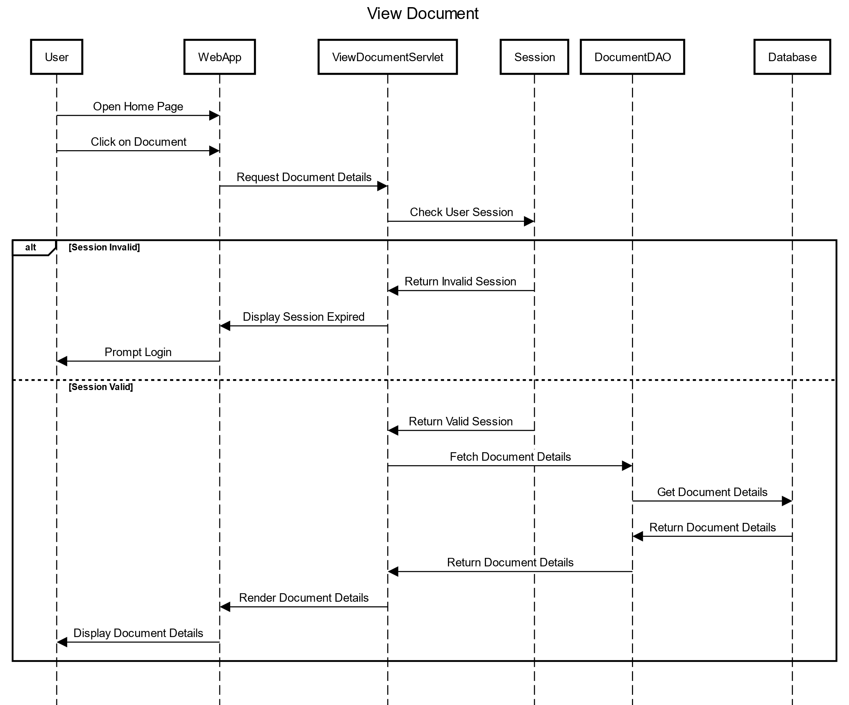

Slide 26
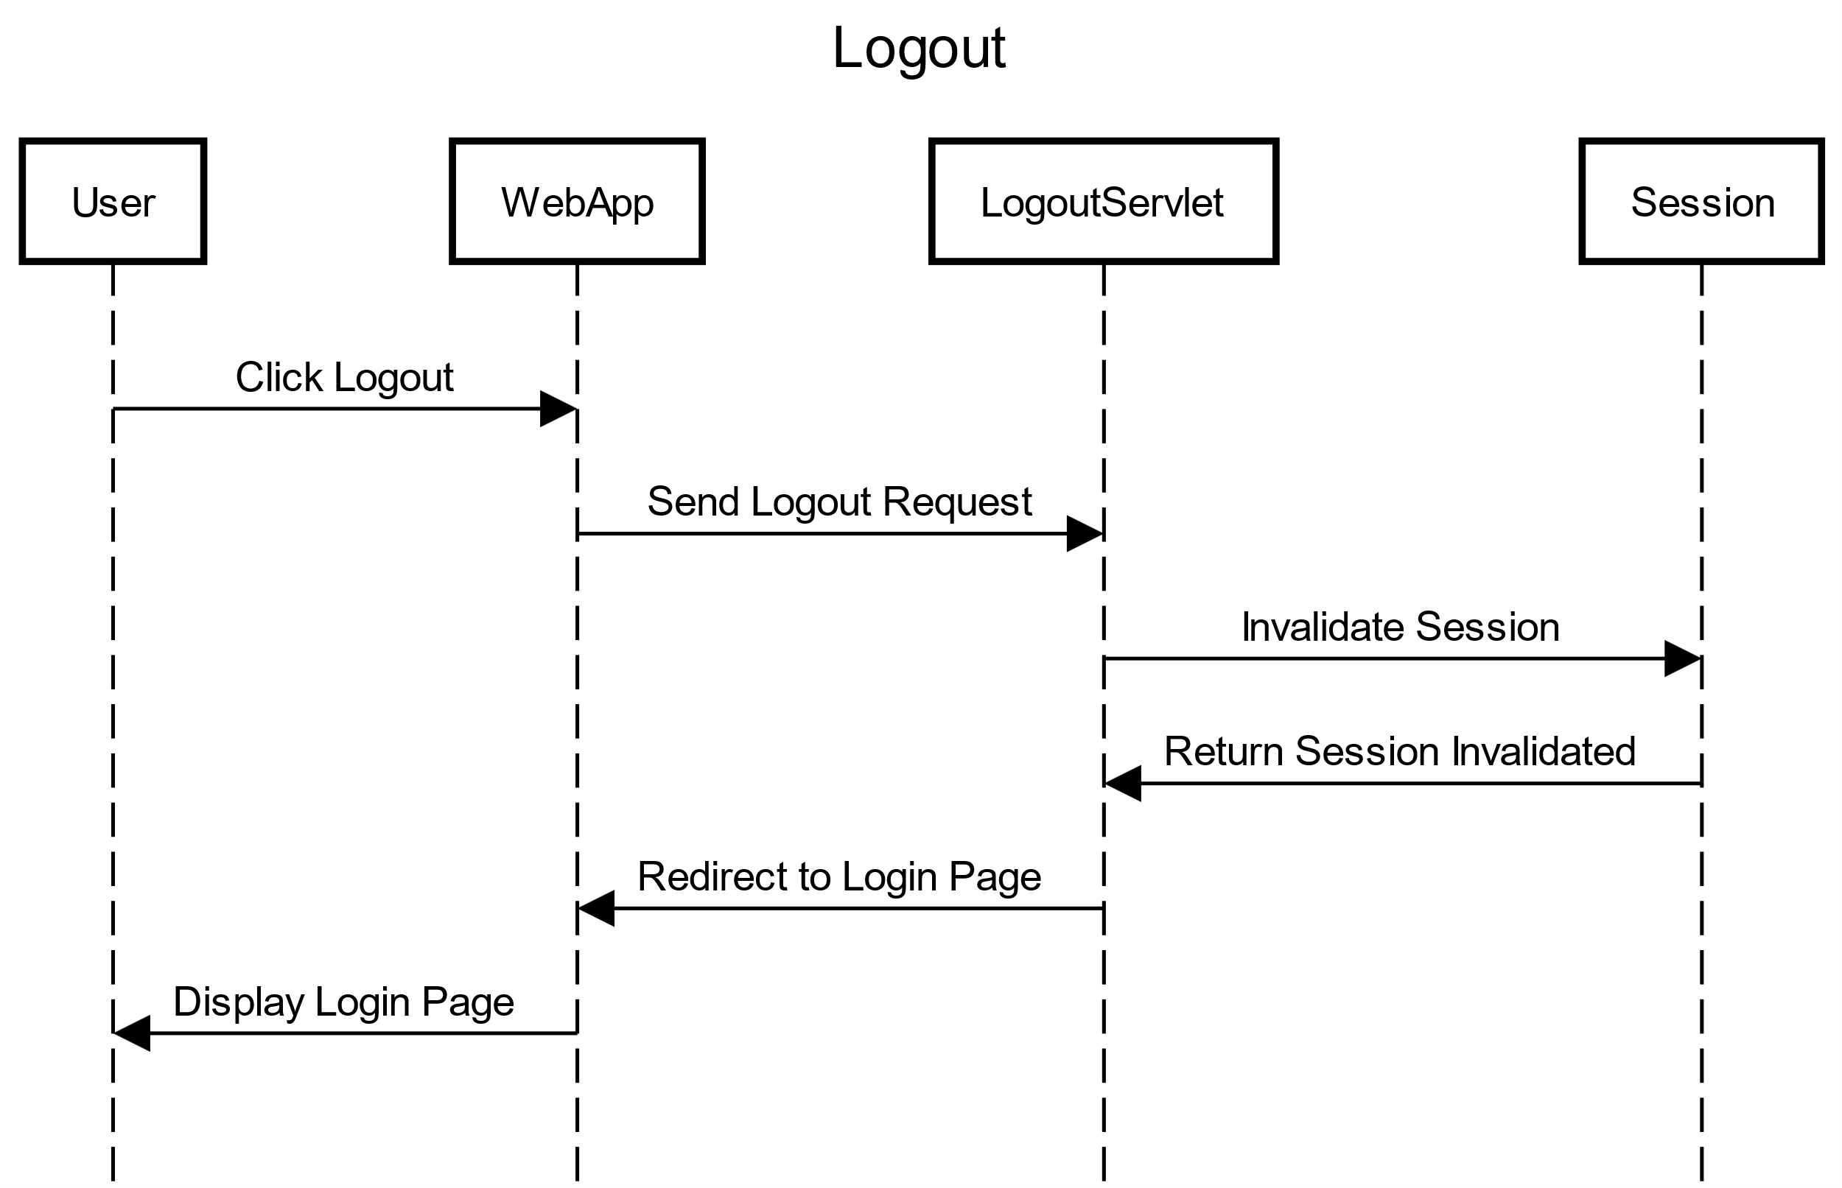

Slide 27
JavaScript version

Slide 28
Document management (JavaScript version)
Implement a client-server web application that modifies the previous specifications as follows:
The application supports registration and login via a public page with appropriate forms. Registration checks the syntactic validity of the email address and the equality between the "password" and "repeat password" fields, also on the client side. Registration ensures the uniqueness of the username.
After user login, the entire application is realized with a single page.
Every user interaction is handled without fully reloading the page, but produces an asynchronous invocation of the server and potentially modifies the content to be updated following the event.
Server-side errors must be reported through an alert message inside the page.
The document moving function is implemented via drag and drop.
The function of creating a subfolder is implemented on the HOME PAGE with an ADD SUBFOLDER button placed next to each folder. Pressing the button brings up an input field to enter the name of the folder to be inserted.
The function of creating a document is implemented on the HOME PAGE with an ADD DOCUMENT button placed next to each folder. Pressing the button brings up an input form to enter the document data.
A folder called "trash" is added. Dragging and dropping a document or folder into the trash results in deletion. Before sending the delete command to the server, the user sees a confirmation modal window and can decide whether to cancel the operation or proceed. Deleting a folder results in the complete and recursive deletion of the contents from the database (documents and folders).

Slide 29
Data Analysis (JavaScript version)
Implement a client-server web application that modifies the previous specifications as follows:
The application supports registration and login via a public page with appropriate forms. Registration checks the syntactic validity of the email address and the equality between the "password" and "repeat password" fields, also on the client side. Registration ensures the uniqueness of the username.
After user login, the entire application is realized with a single page.
Every user interaction is handled without fully reloading the page, but produces an asynchronous invocation of the server and potentially modifies the content to be updated following the event.
Server-side errors must be reported through an alert message inside the page.
The document moving function is implemented via drag and drop.
The function of creating a subfolder is implemented on the HOME PAGE with an ADD SUBFOLDER button placed next to each folder. Pressing the button brings up an input field to enter the name of the folder to be inserted.
The function of creating a document is implemented on the HOME PAGE with an ADD DOCUMENT button placed next to each folder. Pressing the button brings up an input form to enter the document data.
A folder called "trash" is added. Dragging and dropping a document or folder into the trash results in deletion. Before sending the delete command to the server, the user sees a confirmation modal window and can decide whether to cancel the operation or proceed. Deleting a folder results in the complete and recursive deletion of the contents from the database (documents and folders).
Entity Relation Attribute

Slide 30
Requirements analysis (JavaScript version)
Implement a client-server web application that modifies the previous specifications as follows:
The application supports registration and login via a public page with appropriate forms. Registration checks the syntactic validity of the email address and the equality between the "password" and "repeat password" fields, also on the client side. Registration ensures the uniqueness of the username.
After user login, the entire application is realized with a single page.
Every user interaction is handled without fully reloading the page, but produces an asynchronous invocation of the server and potentially modifies the content to be updated following the event.
Server-side errors must be reported through an alert message inside the page.
The document moving function is implemented via drag and drop.
The function of creating a subfolder is implemented on the HOME PAGE with an ADD SUBFOLDER button placed next to each folder. Pressing the button brings up an input field to enter the name of the folder to be inserted.
The function of creating a document is implemented on the HOME PAGE with an ADD DOCUMENT button placed next to each folder. Pressing the button brings up an input form to enter the document data.
A folder called "trash" is added. Dragging and dropping a document or folder into the trash results in deletion. Before sending the delete command to the server, the user sees a confirmation modal window and can decide whether to cancel the operation or proceed. Deleting a folder results in the complete and recursive deletion of the contents from the database (documents and folders).
Pages View components Events Actions

Slide 31
Database ERD

Slide 32
Database schema (users)
CREATE TABLE `users` (
`id` int NOT NULL AUTO_INCREMENT,
`username` varchar(45) NOT NULL,
`email` varchar(45) NOT NULL,
`password` varchar(45) NOT NULL,
PRIMARY KEY (`id`),
UNIQUE KEY `email_UNIQUE` (`email`),
UNIQUE KEY `username_UNIQUE` (`username`),
UNIQUE KEY `id_UNIQUE` (`id`)
) ENGINE=InnoDB AUTO_INCREMENT=3 DEFAULT CHARSET=utf8mb4 COLLATE=utf8mb4_0900_ai_ci

Slide 33
Database schema (folders)
CREATE TABLE `folders` (
`id` int NOT NULL AUTO_INCREMENT,
`name` varchar(255) NOT NULL,
`user_id` int NOT NULL,
`parent_id` int DEFAULT NULL,
`created_at` timestamp NULL DEFAULT CURRENT_TIMESTAMP,
PRIMARY KEY (`id`),
KEY `fk_folders_users` (`user_id`),
KEY `fk_folders_parent` (`parent_id`),
CONSTRAINT `fk_folders_parent` FOREIGN KEY (`parent_id`) REFERENCES `folders` (`id`),
CONSTRAINT `fk_folders_users` FOREIGN KEY (`user_id`) REFERENCES `users` (`id`)
) ENGINE=InnoDB AUTO_INCREMENT=52 DEFAULT CHARSET=utf8mb4 COLLATE=utf8mb4_0900_ai_ci

Slide 34
Database schema (documents)
CREATE TABLE `documents` (
`id` int NOT NULL AUTO_INCREMENT,
`name` varchar(255) NOT NULL,
`folder_id` int DEFAULT NULL,
`user_id` int NOT NULL,
`created_at` timestamp NULL DEFAULT CURRENT_TIMESTAMP,
`summary` text, `type` varchar(255) DEFAULT NULL,
PRIMARY KEY (`id`), KEY `folder_id` (`folder_id`),
KEY `fk_documents_users` (`user_id`),
CONSTRAINT `documents_ibfk_1` FOREIGN KEY (`folder_id`) REFERENCES `folders` (`id`) ON DELETE CASCADE,
CONSTRAINT `fk_documents_users` FOREIGN KEY (`user_id`) REFERENCES `users` (`id`)
) ENGINE=InnoDB AUTO_INCREMENT=29 DEFAULT CHARSET=utf8mb4 COLLATE=utf8mb4_0900_ai_ci

Slide 35
Components
Model objects (Beans)
User
Document
Folder
Views
login.html
register.html
home.html
Filters
AuthenticationFilter
Controllers (Servlets)
UserRegisterServlet
LoginServlet
LogoutServlet
FolderServlet
DocumentServlet
Utils
DatabaseUtils

Slide 36
Compnents (DAO)
UserDAO
doesUsernameExist(username)
doesEmailExist(email)
registerUser(User user)
authenticateUser(username, password)
DocumentDAO
getDocumentsByFolder(folderId)
getDocumentById(documentId)
moveDocument(documentId, newFolderId)
addDocument(document)
deleteDocument(documentId)
FolderDAO
getAllFolders(userId)
addFolder(folder)
deleteFolderRecursively(folderId)
getSubFolderIds(parentId, conn)
deleteDocumentsInFolder(folderId, conn)
deleteFolderById(folderId, conn)

Slide 37
Components (JavaScript)
login.js
register.js
home.js
handleBinDragOver(event)
handleBinDrop(event)
handleDragStart(event, itemId, itemType)
handleDrop(event, folderId)
loadFolders()
buildFolderTree(folders)
addRootFolder()
addSubfolder(parentId)
displayFolders(folders, parentElement, level = 0)
handleDragOver(event)
loadDocuments(folderId, parentElement, level)
viewDocument(docId)
displayDocumentDetails(document)
displayDocuments(documents, parentElement, level)
moveDocument(docId, newFolderId)
addDocument(folderId)
deleteDocument(documentId)
deleteFolder(folderId)
getCurrentFolderId()
logout()

Slide 38
IFML diagram (JavaScript)

Slide 39
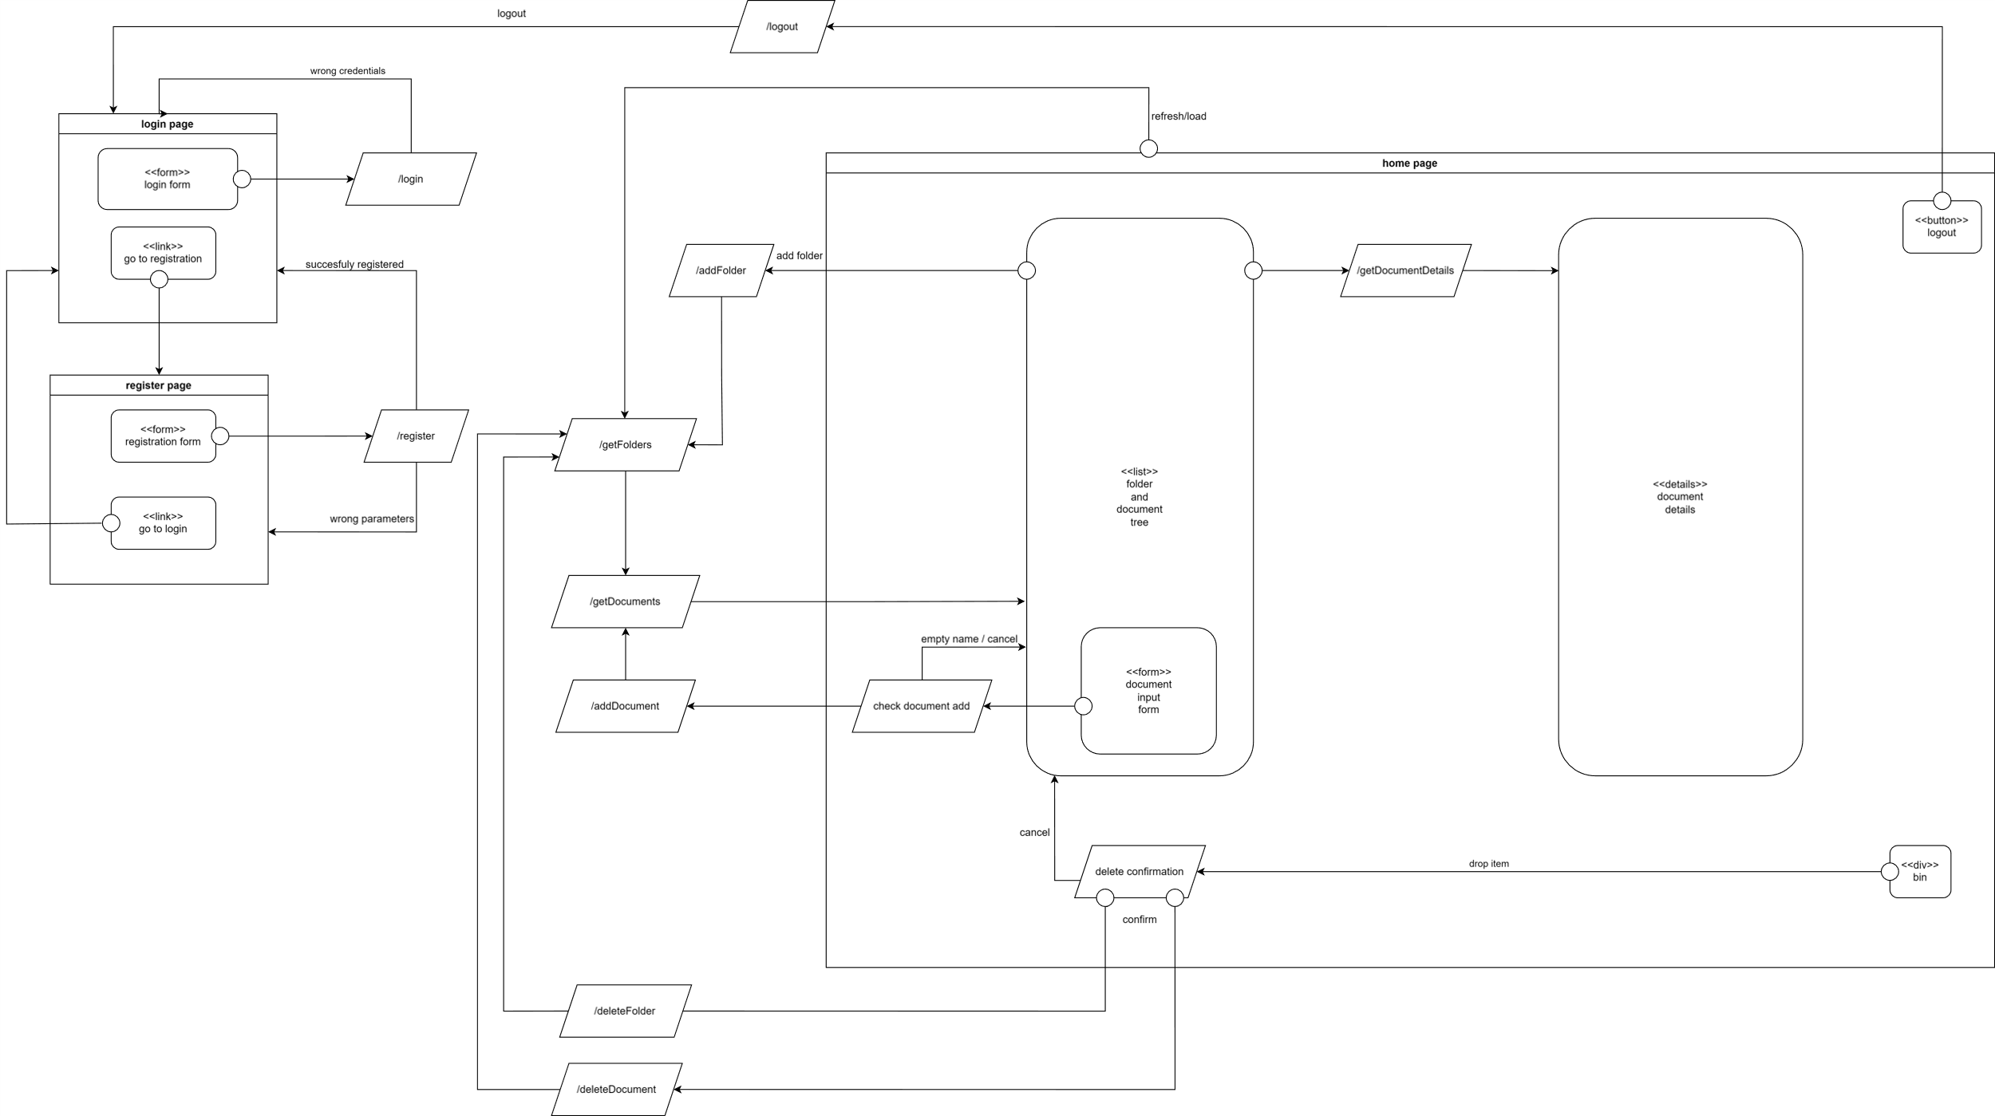
IFML diagram

Slide 40
Sequence diagrams (JavaScript version)

Slide 41
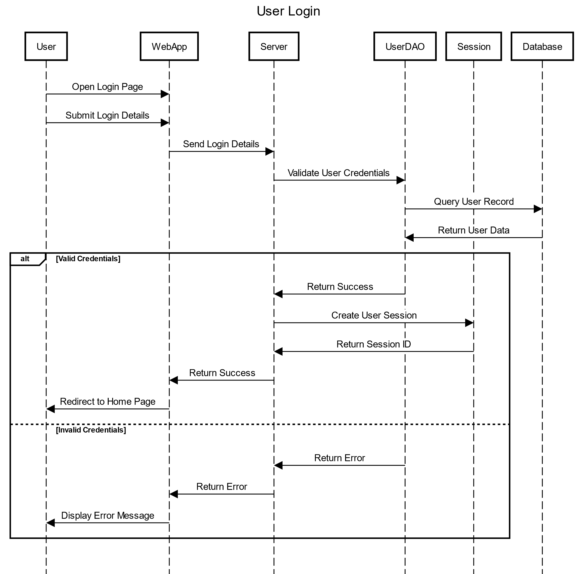

Slide 42
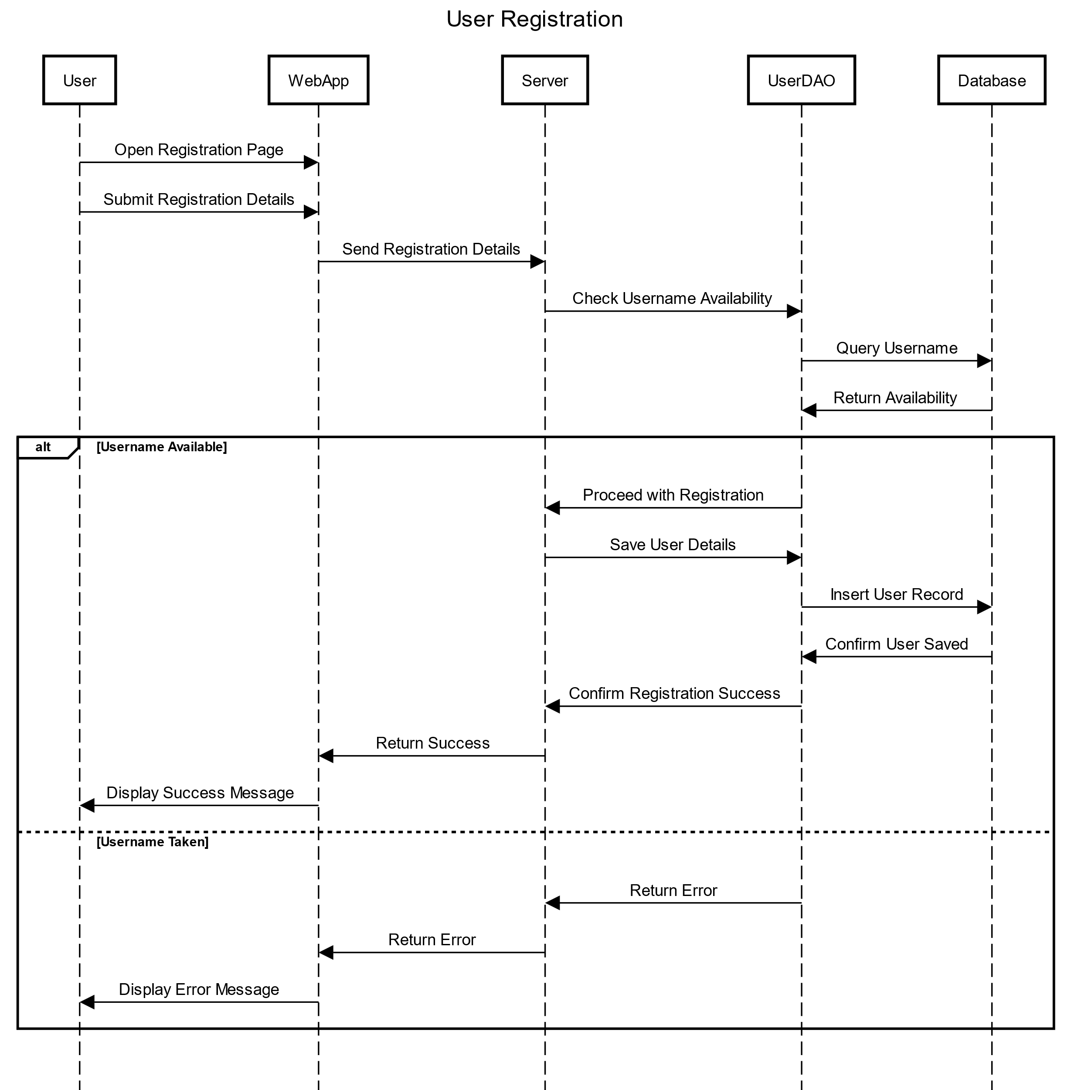

Slide 43
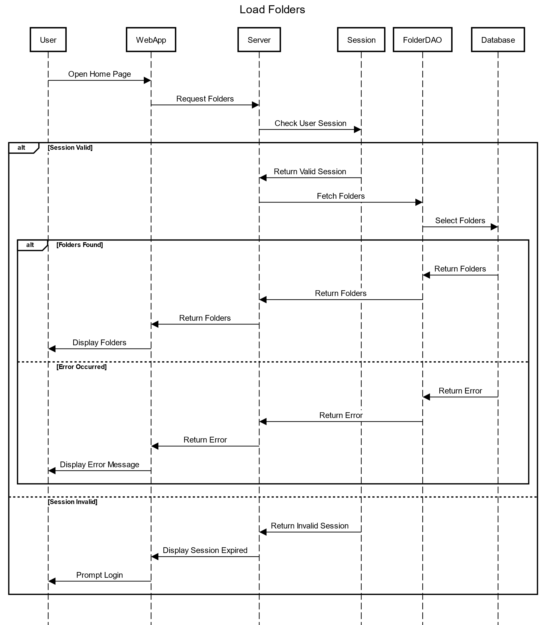

Slide 44
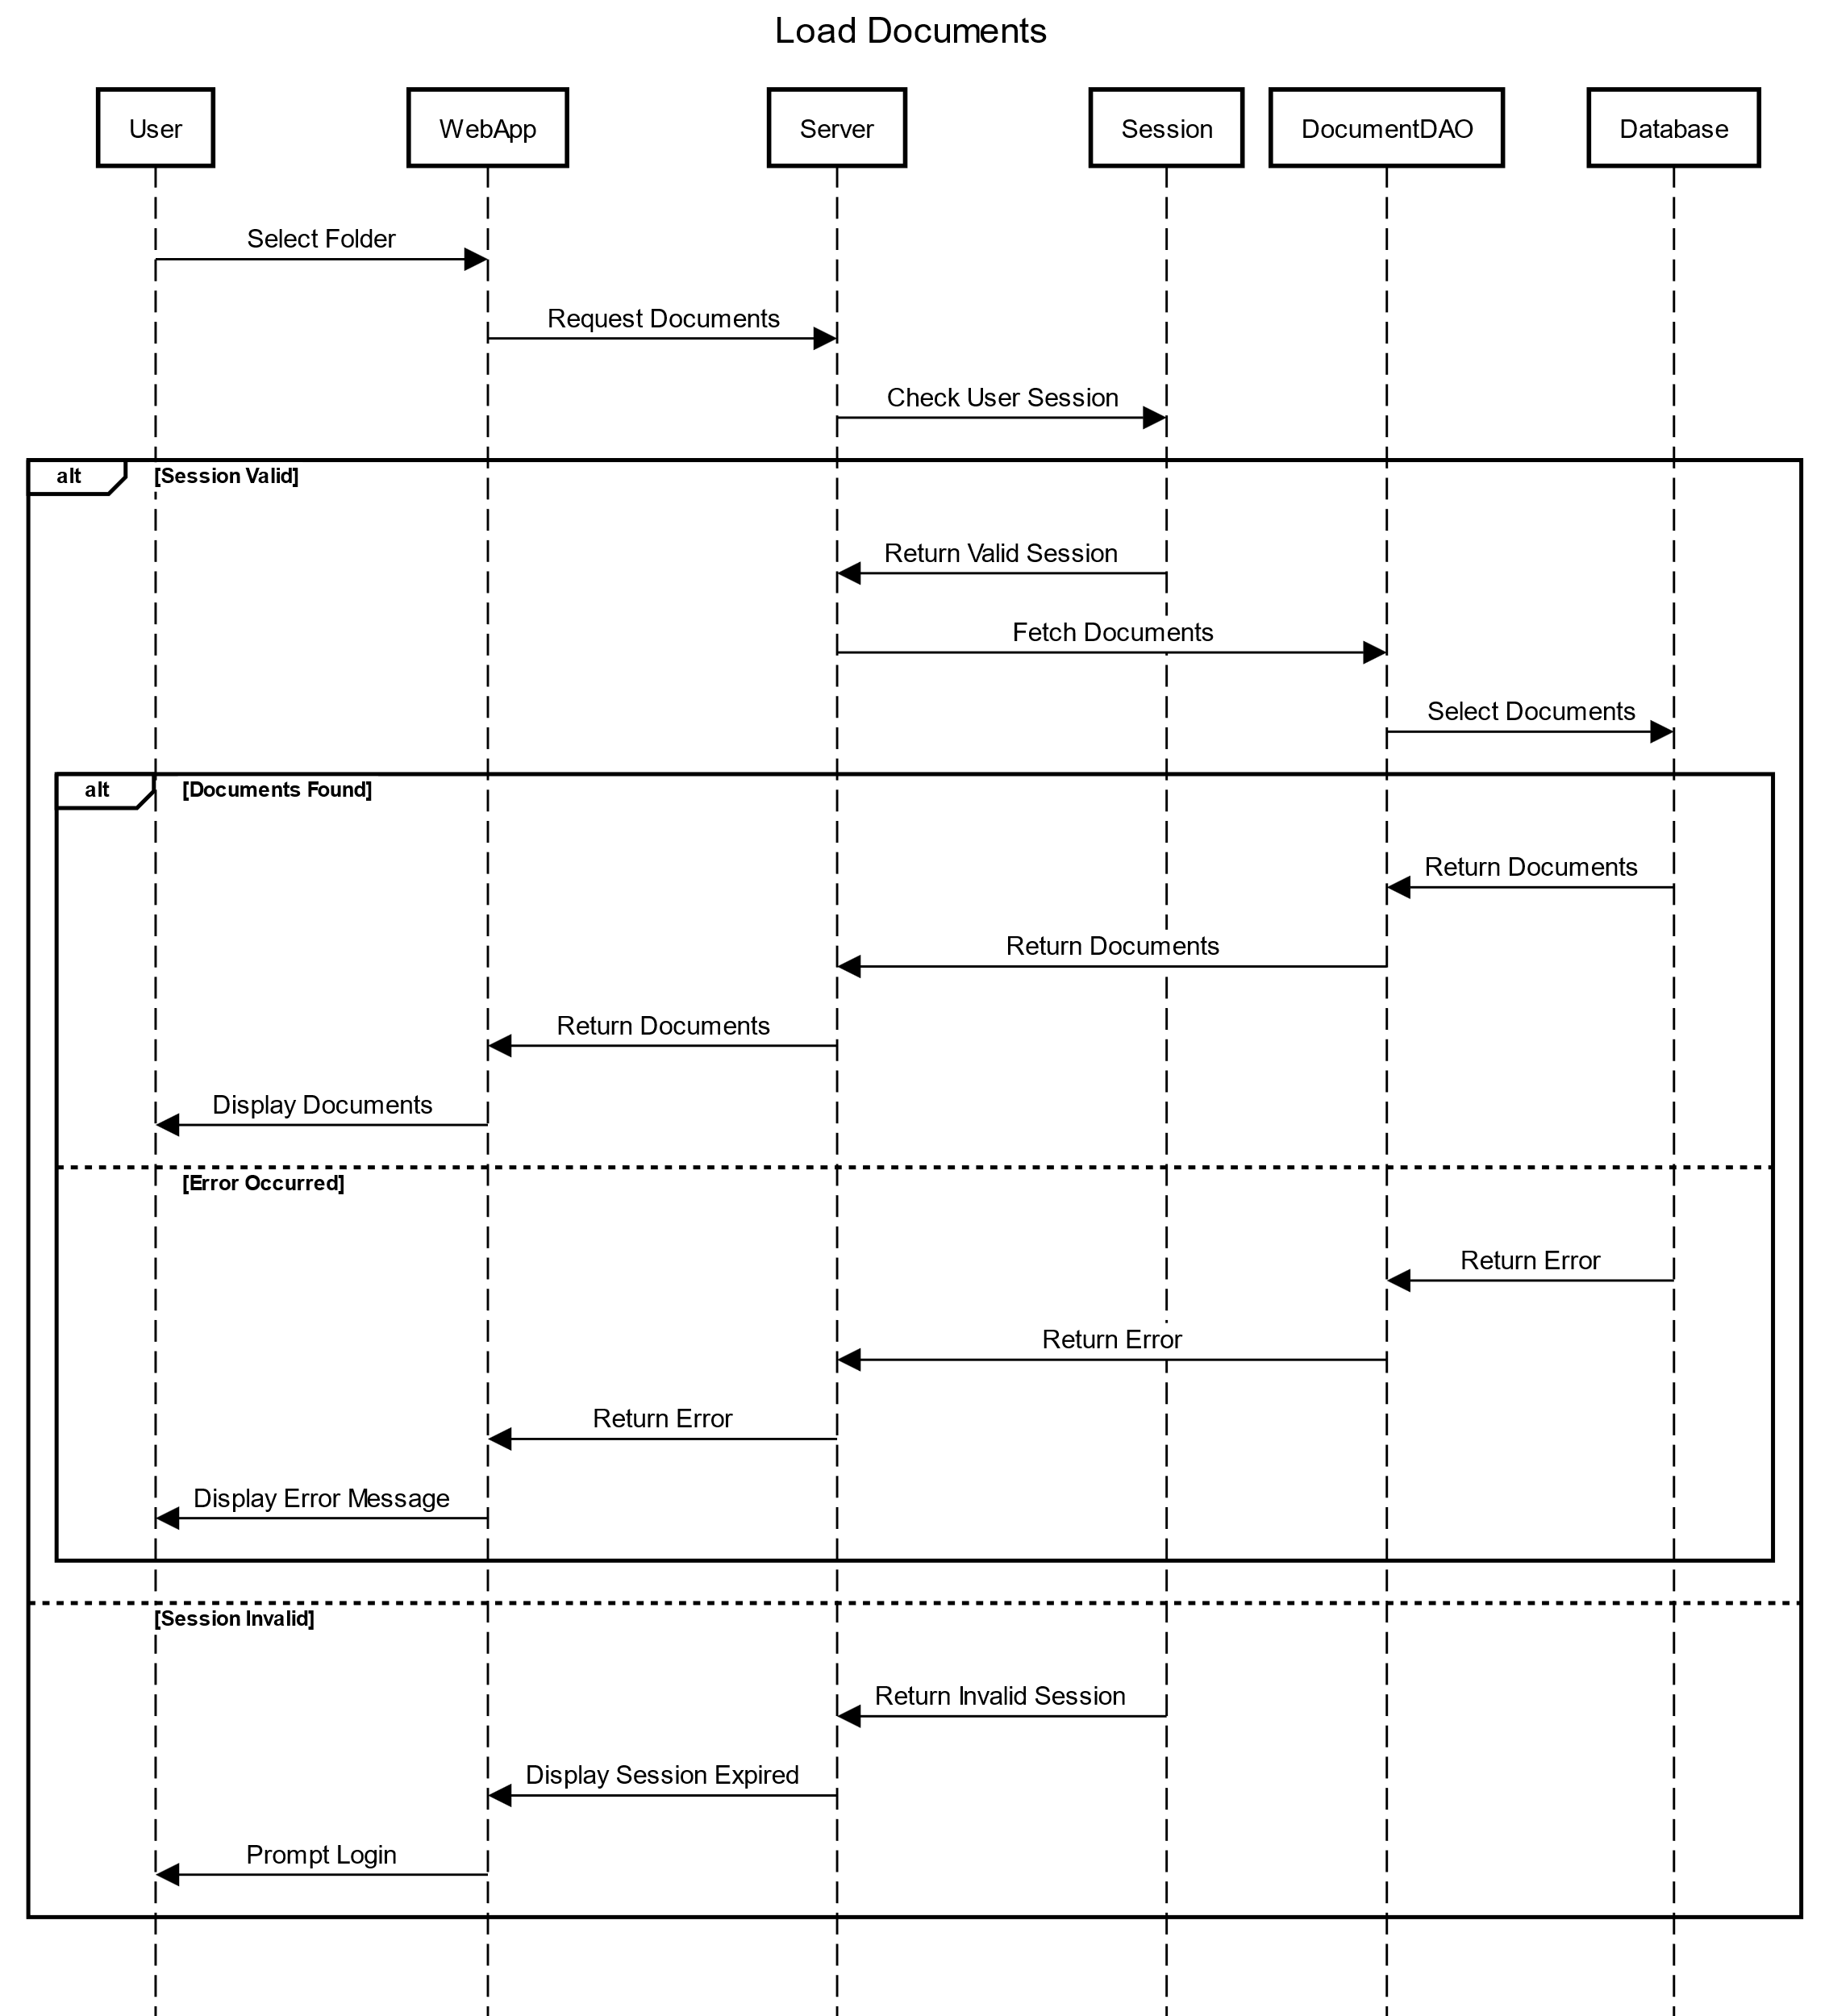

Slide 45
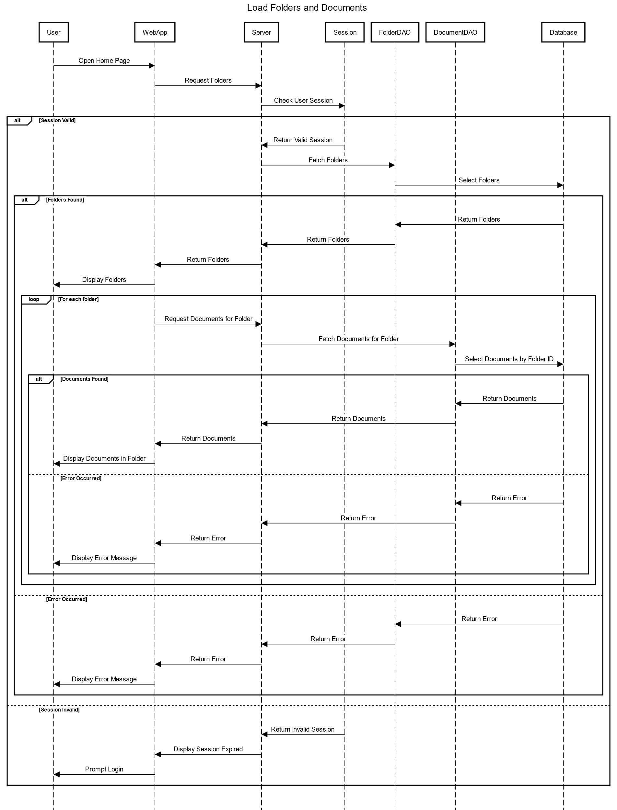

Slide 46
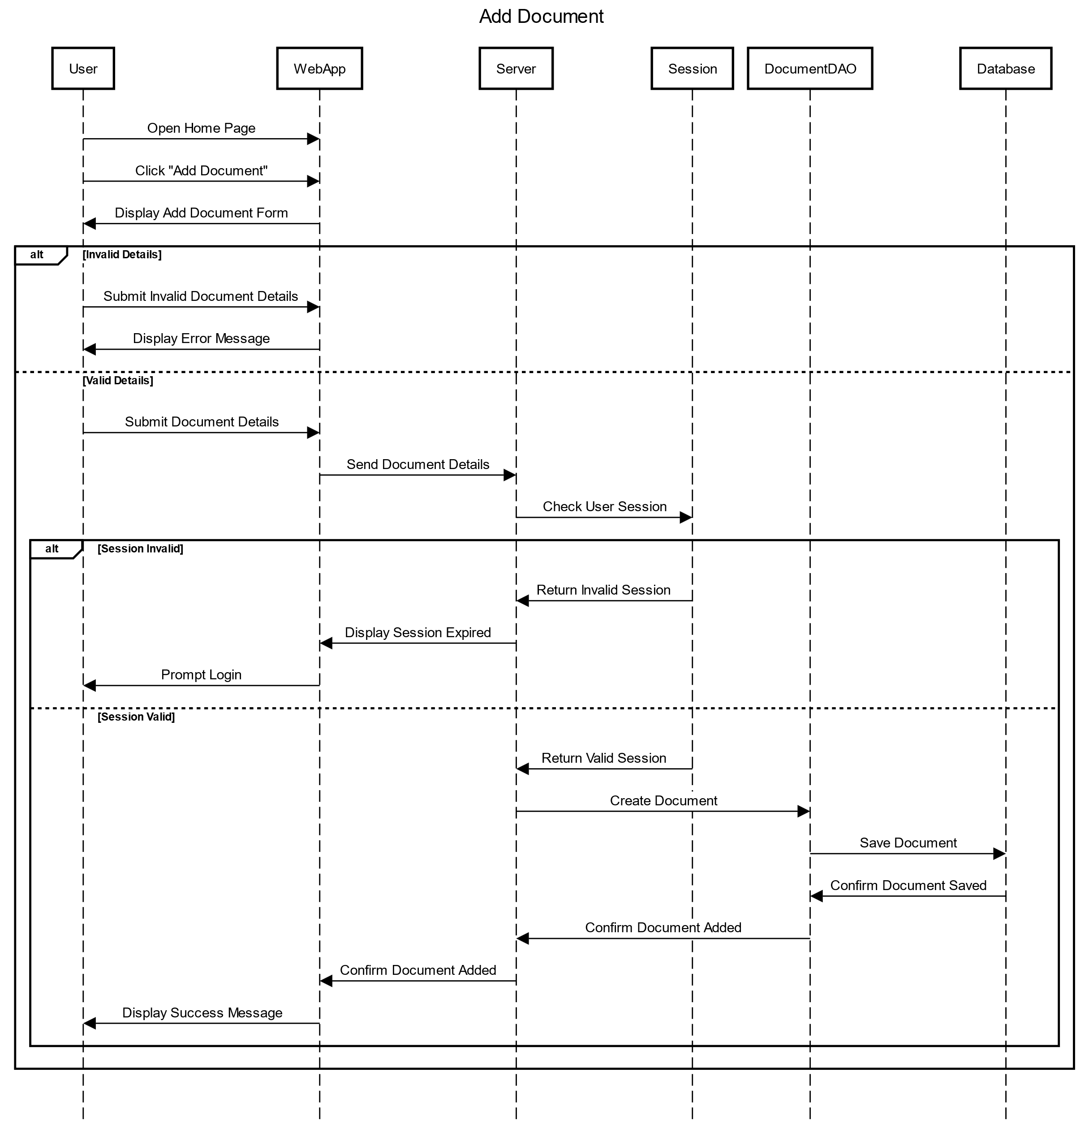

Slide 47
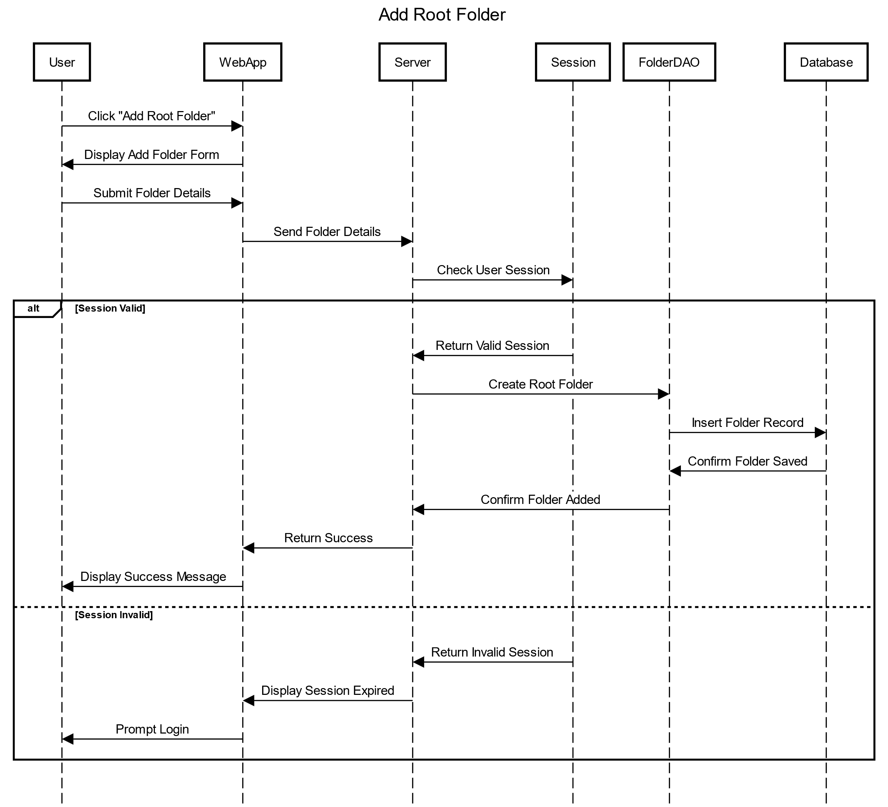

Slide 48
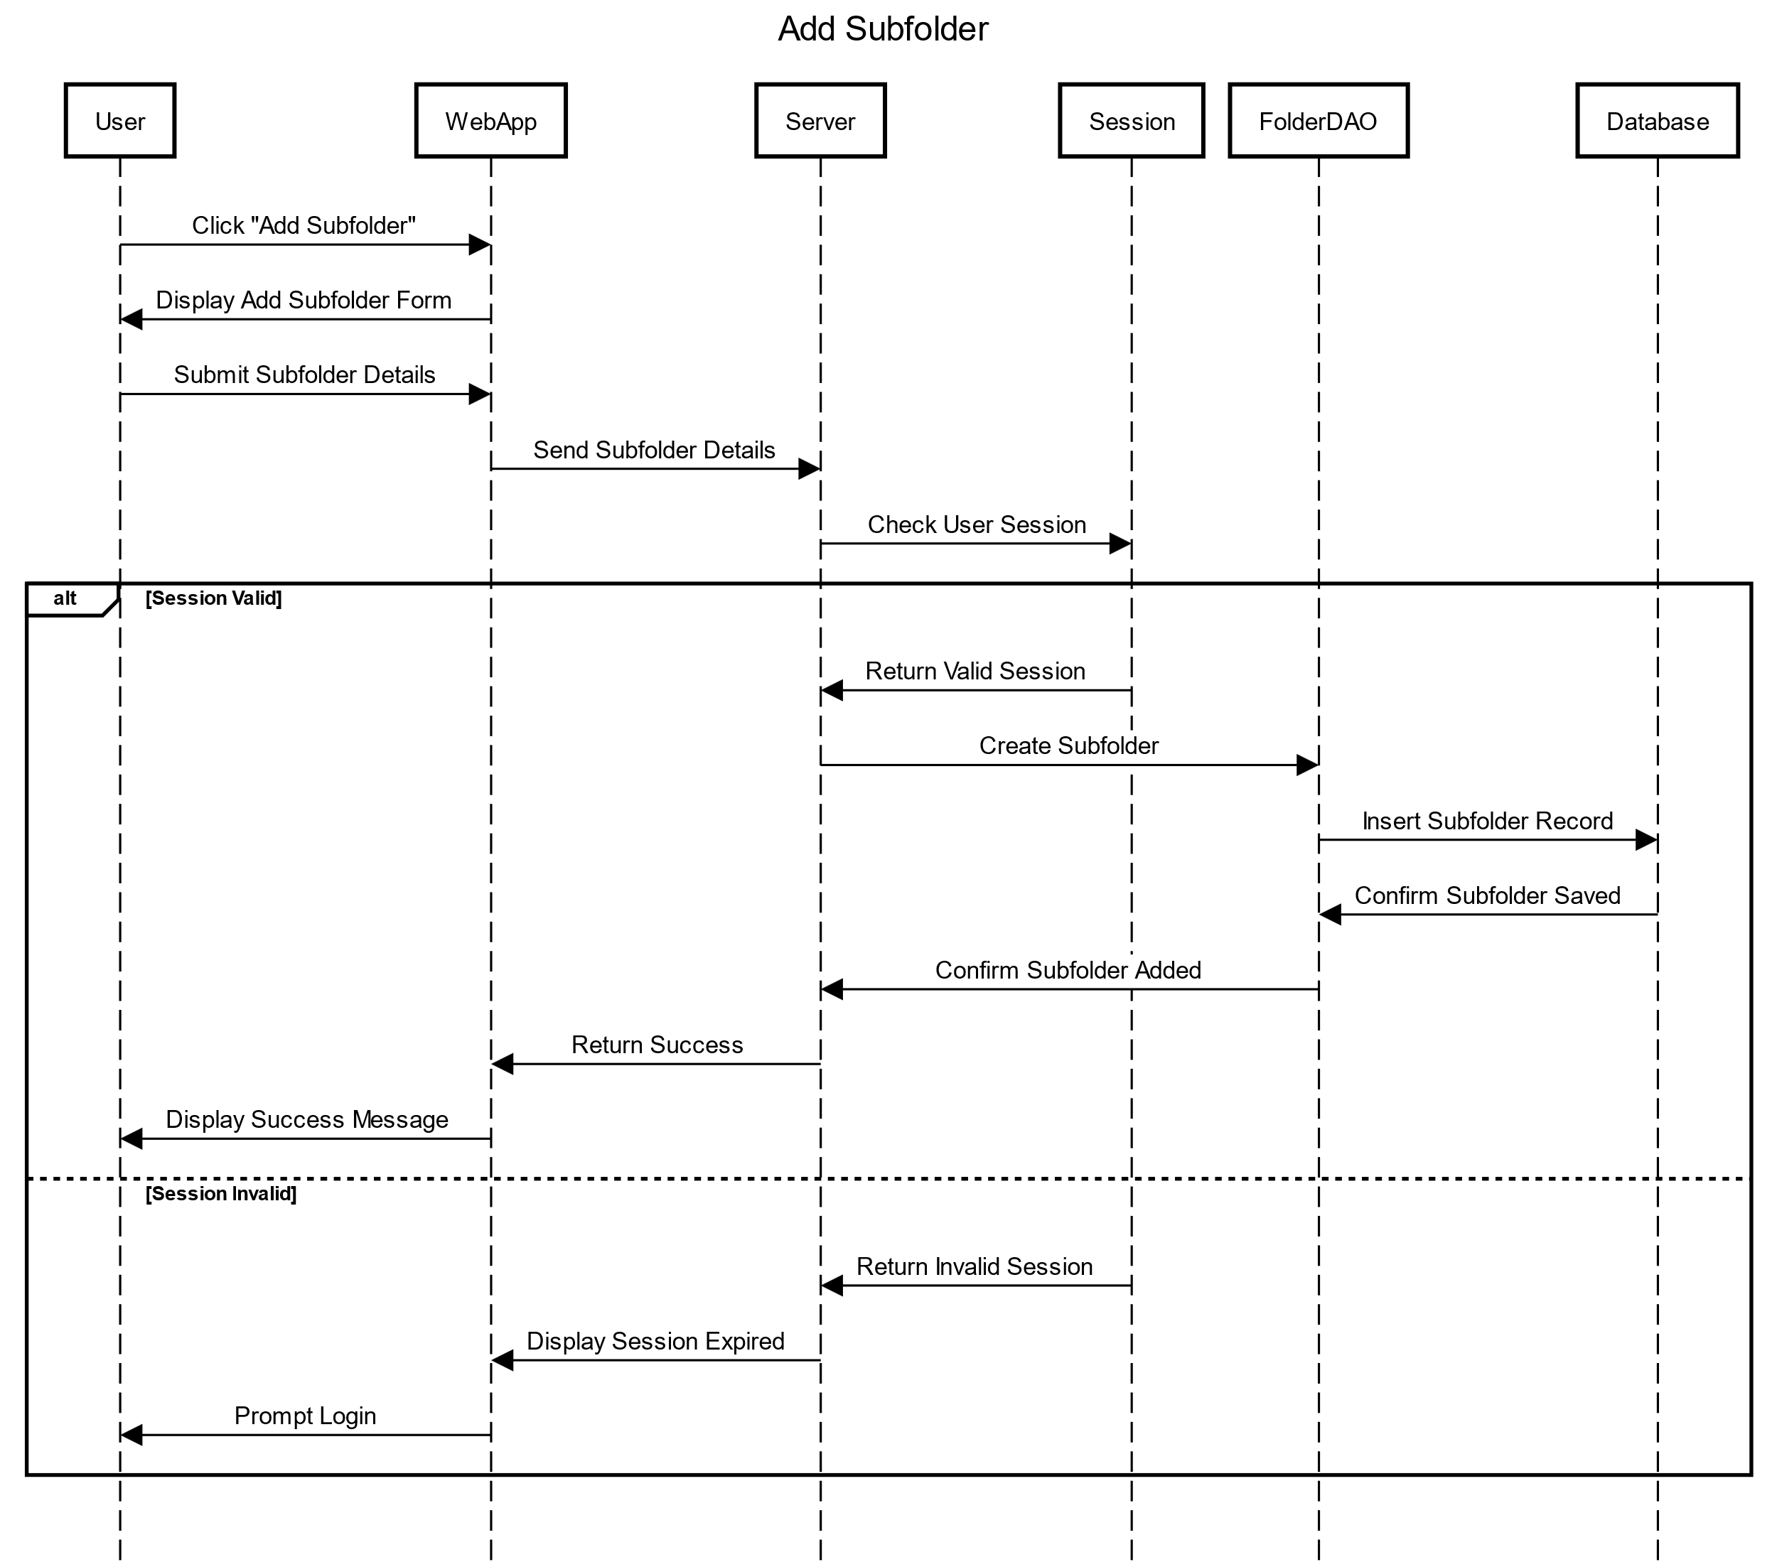

Slide 49
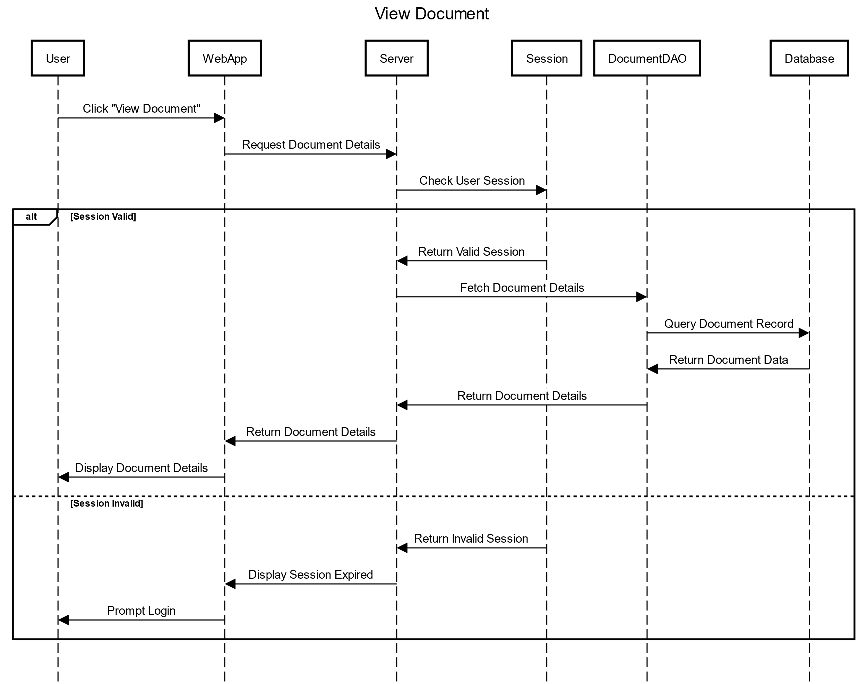

Slide 50
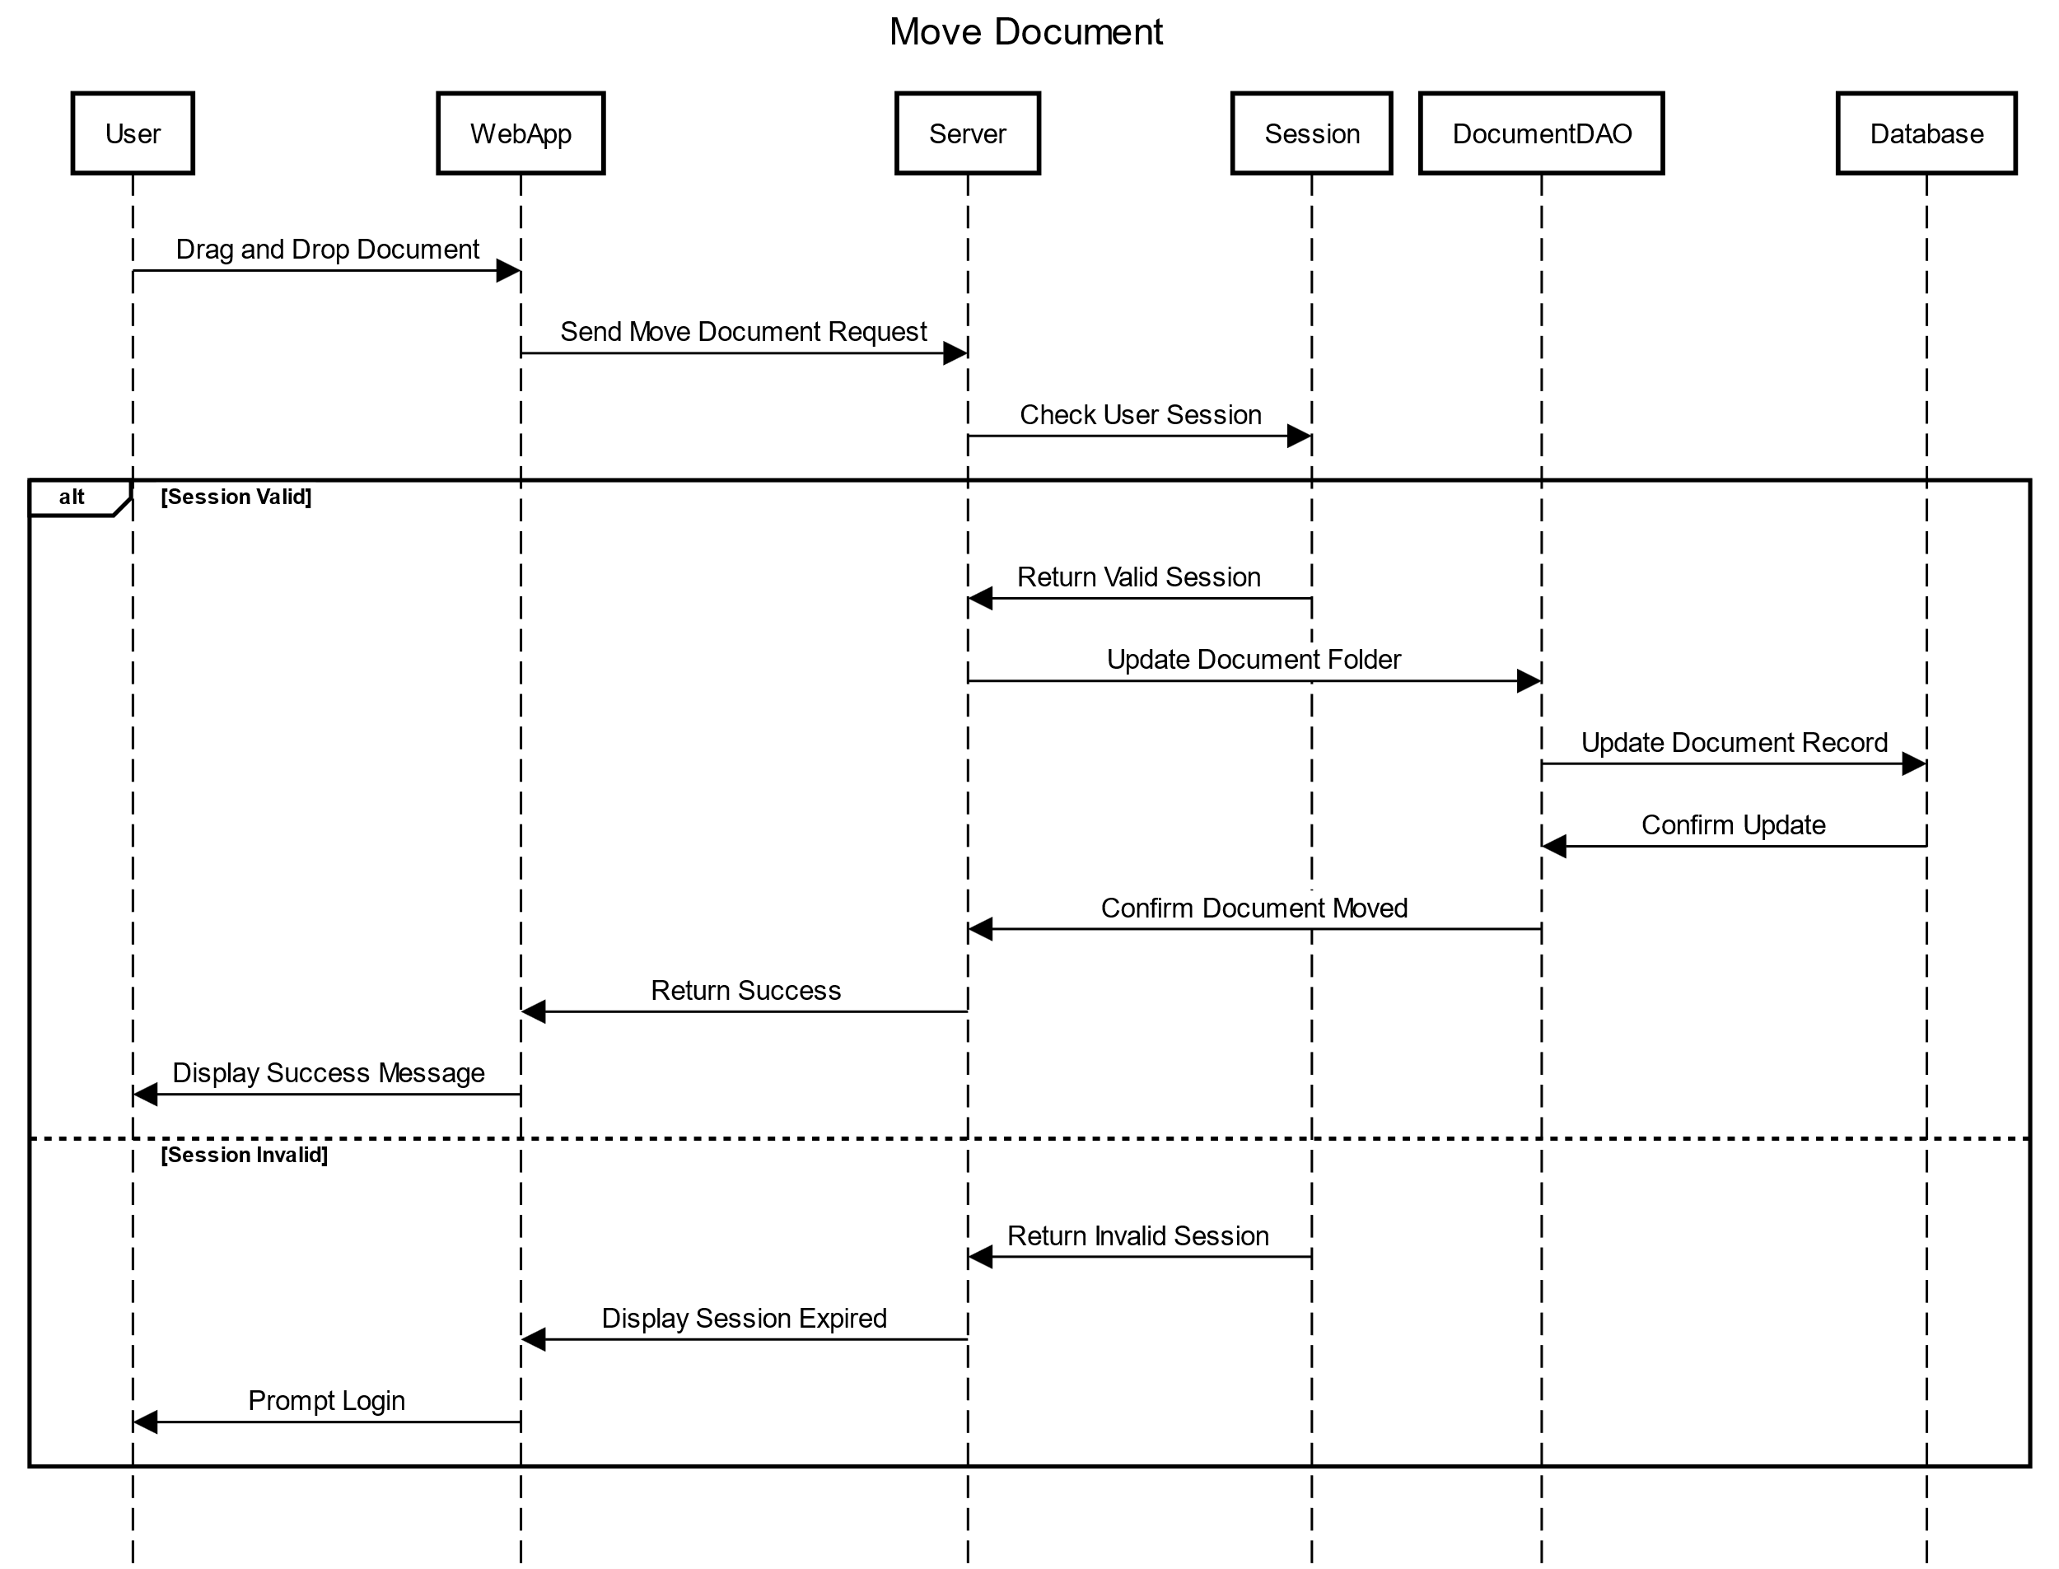

Slide 51
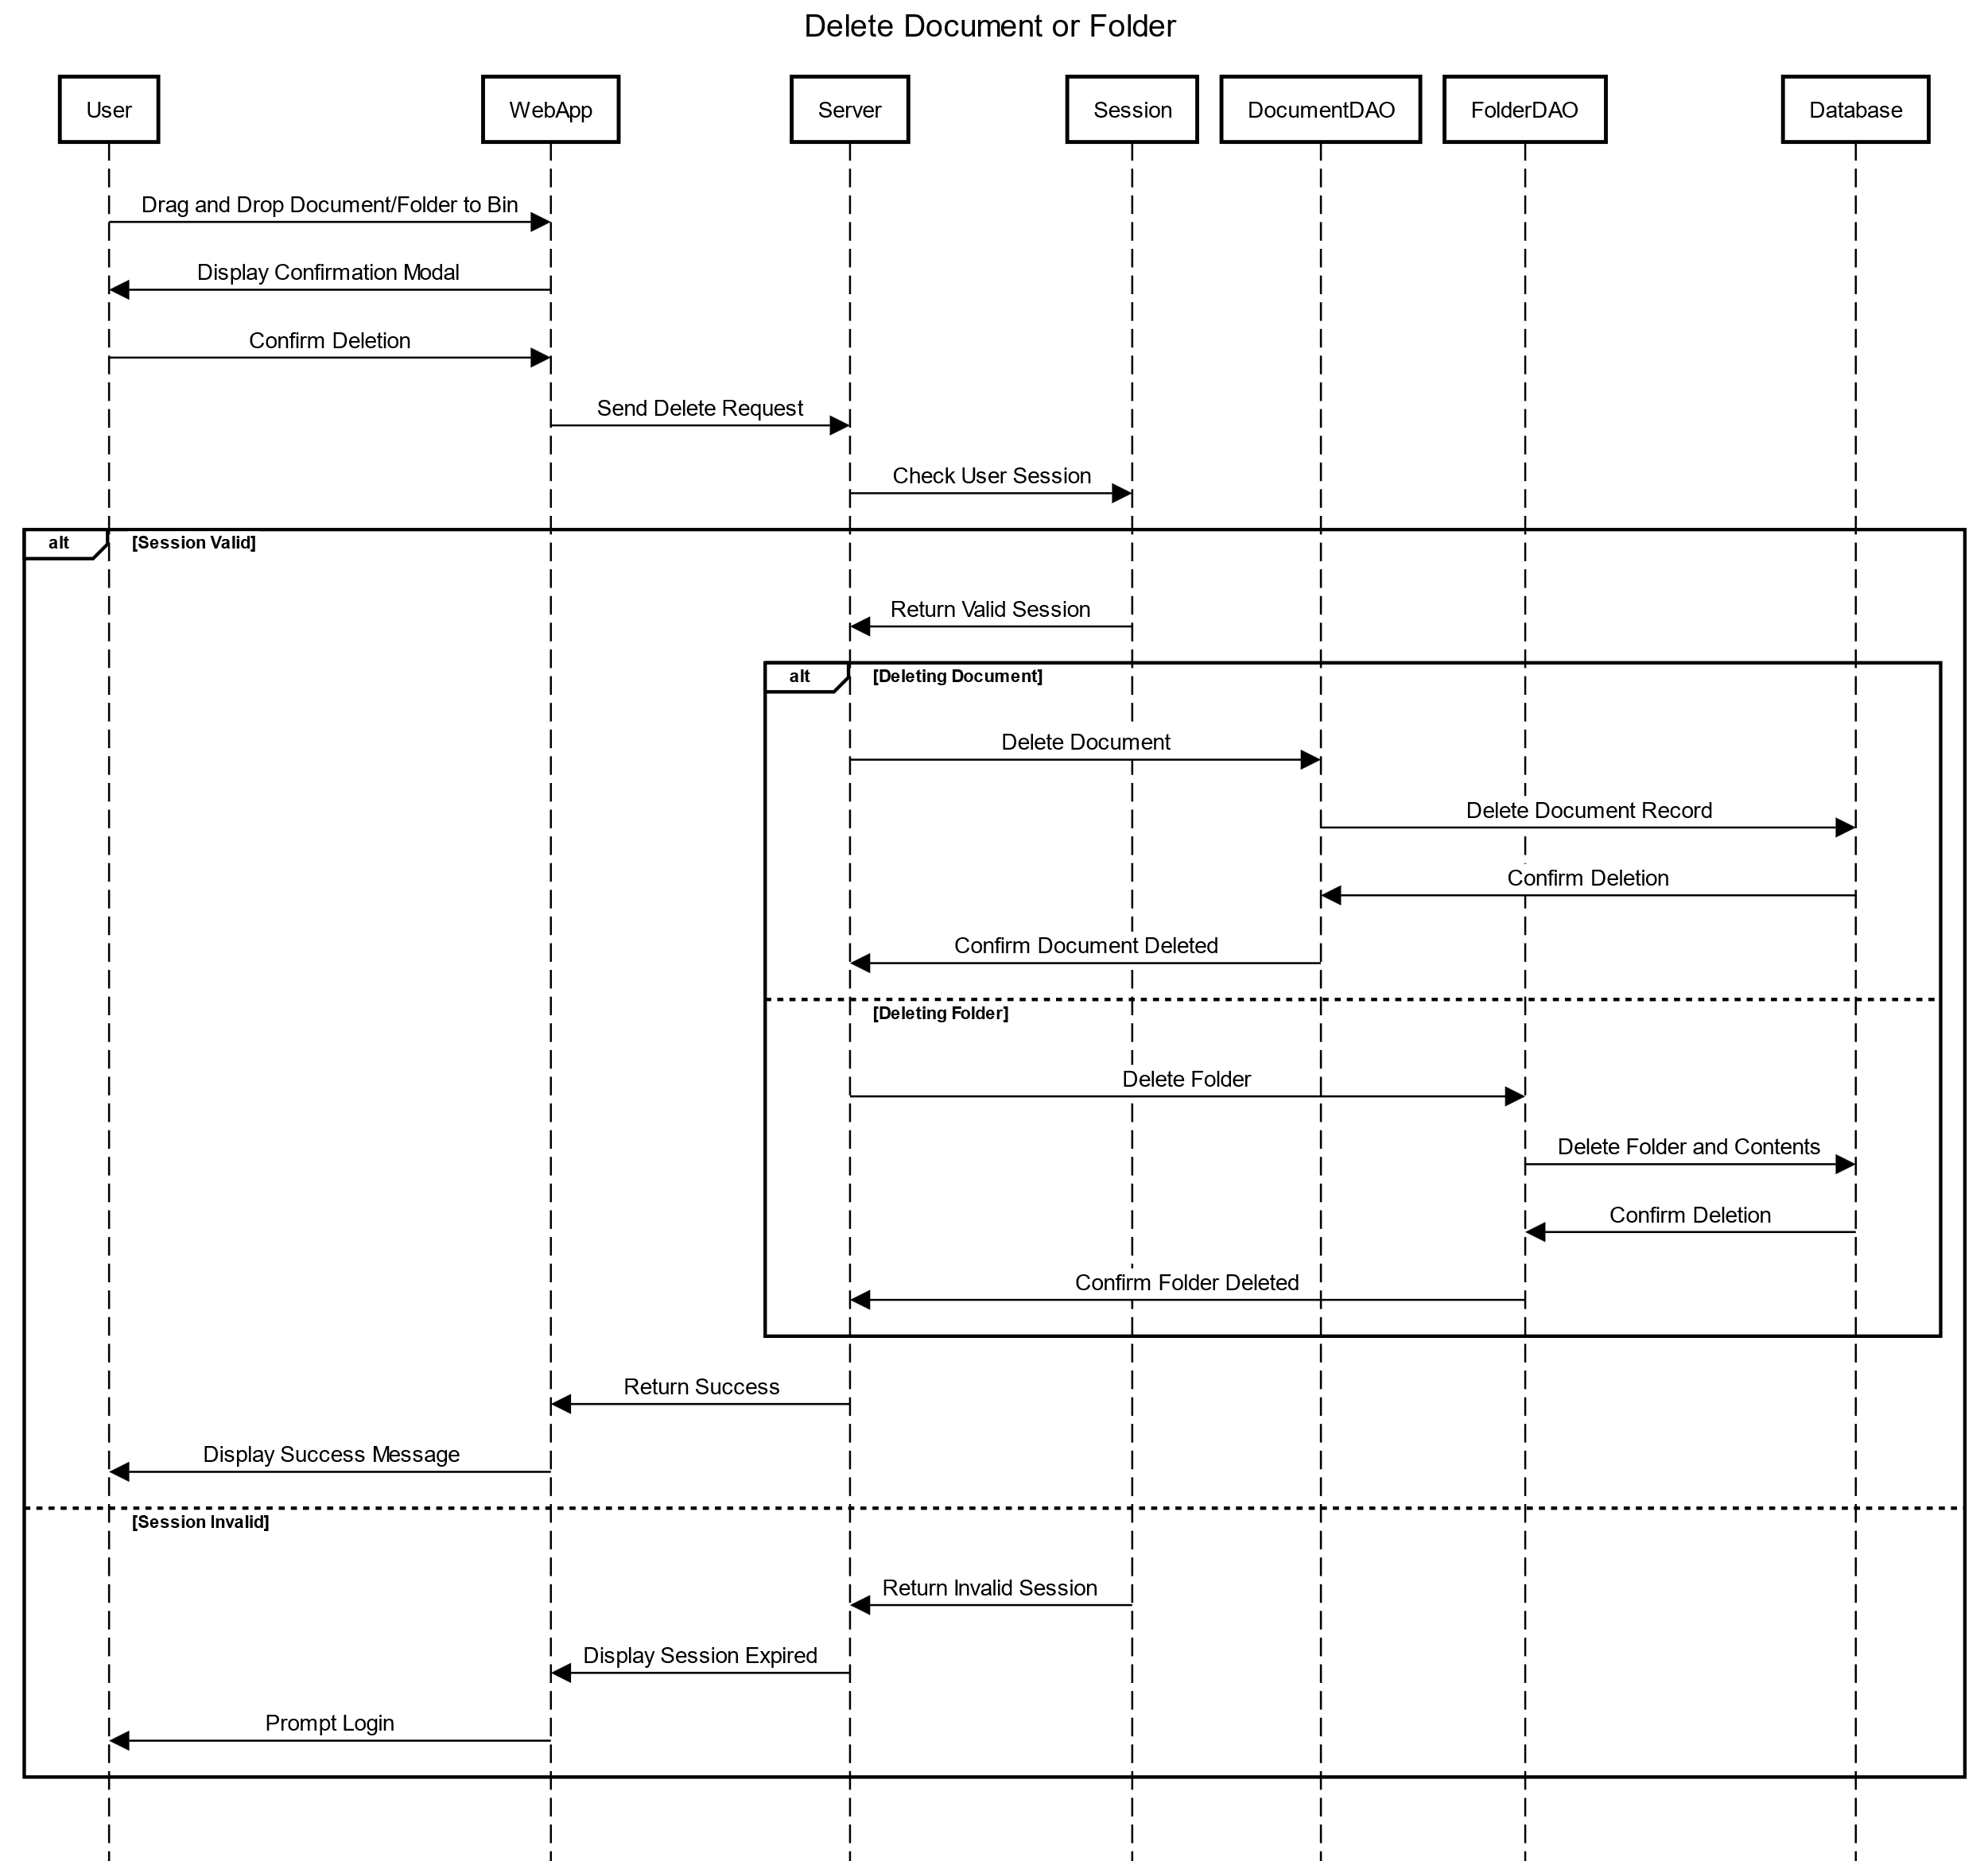

Slide 52
